Slide 1
Ronald Harvey Kindergarten
Notes:
Matt - Welcome and introductions - Kindergarten team

Slide 2
Our Kindergarten
Notes:
Matt - Explaining kindergarten options (half day/full day) and introduce video

Slide 3
How old does my child need to be to register for kindergarten?
2025/2026 School Year
Children must be at least 4 yrs 8 months of age but less than 6 years of age on Sept. 1, 2025 to register for Kindergarten. (They must turn 5 on or by Dec. 31, 2025)
Notes:
Megan *the information in these slides will be posted on our webpage after today - some links in here as well
-If you have questions about this cutoff date and would like to talk about your child’s readiness we will be in the classrooms after and can speak to you individually

Slide 4
Kindergarten Learning
The kindergarten program is made up of seven areas of child development.
Visit LearnAlberta to explore these areas of development through their
Early Numeracy
Early
Literacy
Citizenship & Identity
Child Development
Creative Expression
Environment & Community Awareness
Physical Skills & Well-being
Personal & Social Responsibility
Notes:
Kim - read out the areas
This fall we are starting to teach the new Social studies curriculum.
You can access the Kindergarten outcomes using the link on this page to learn Alberta.

Slide 5
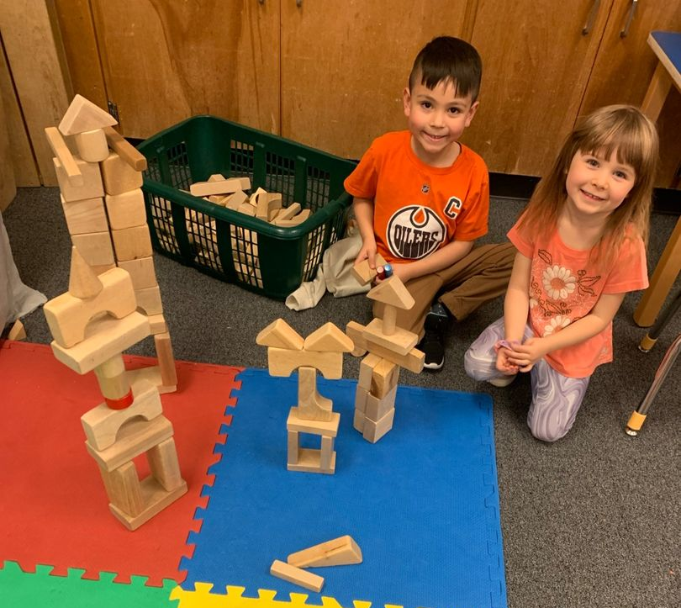
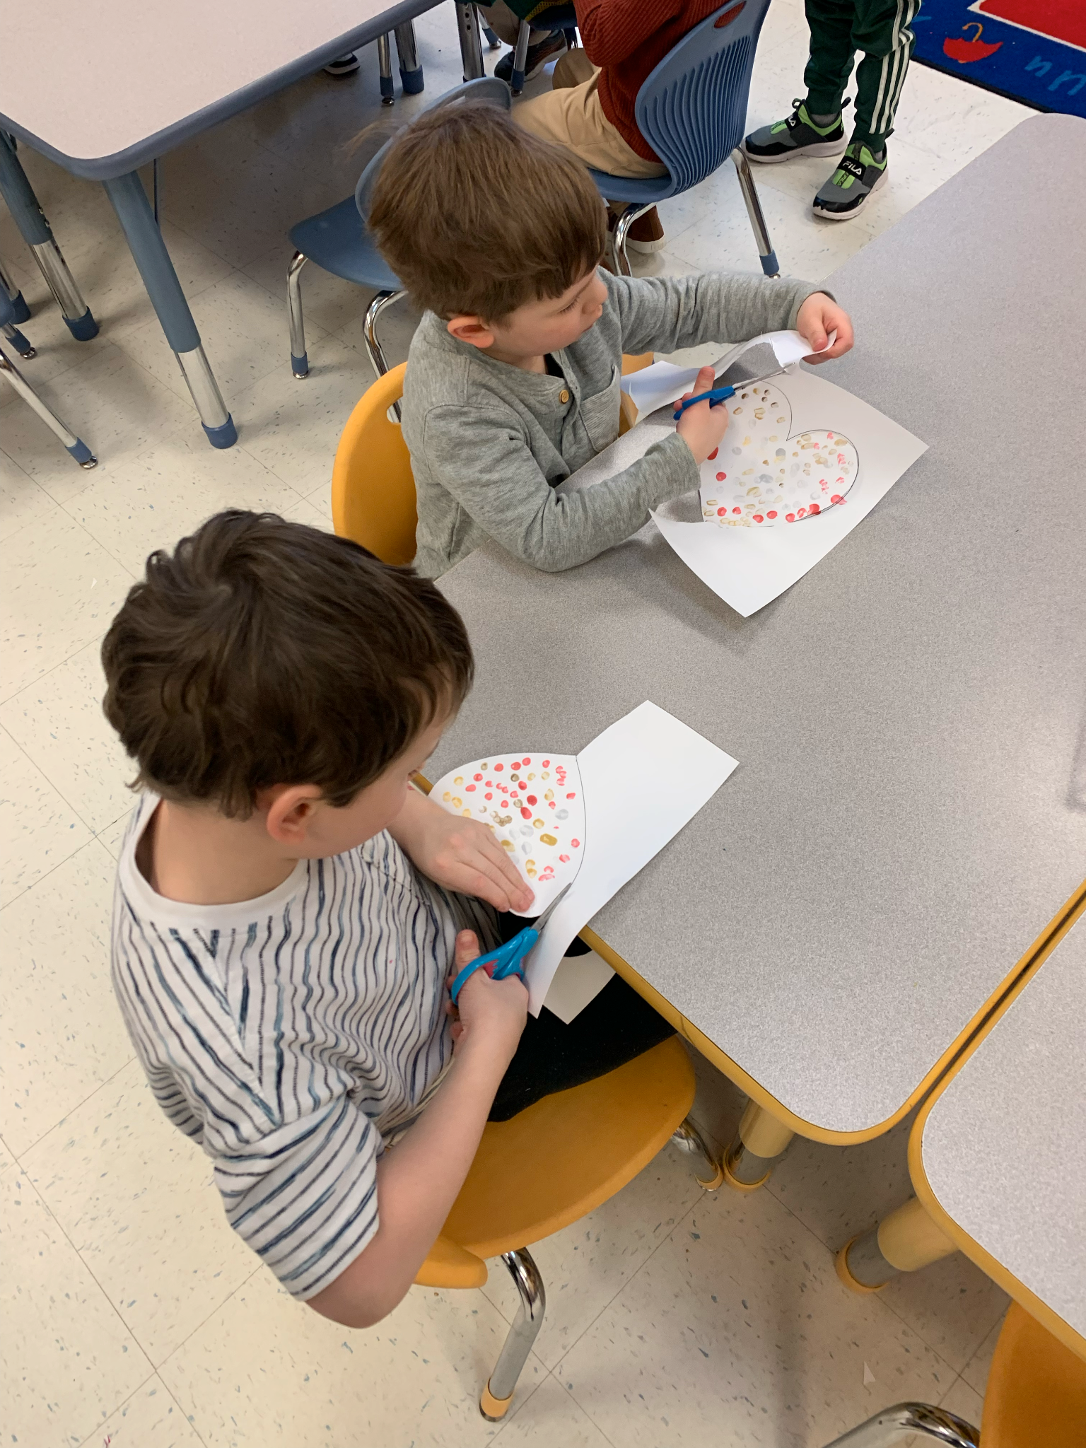
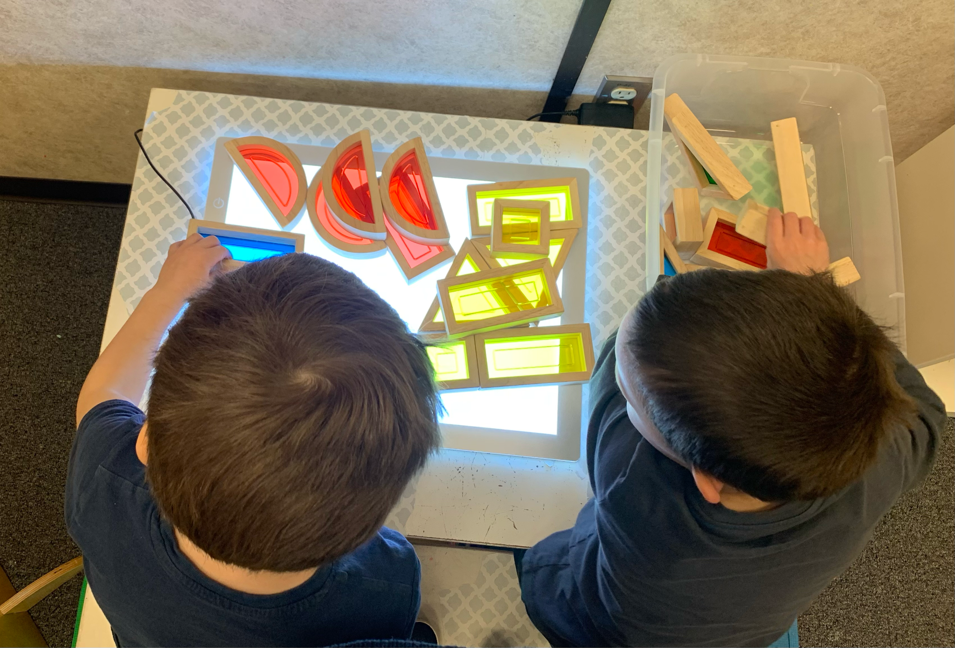
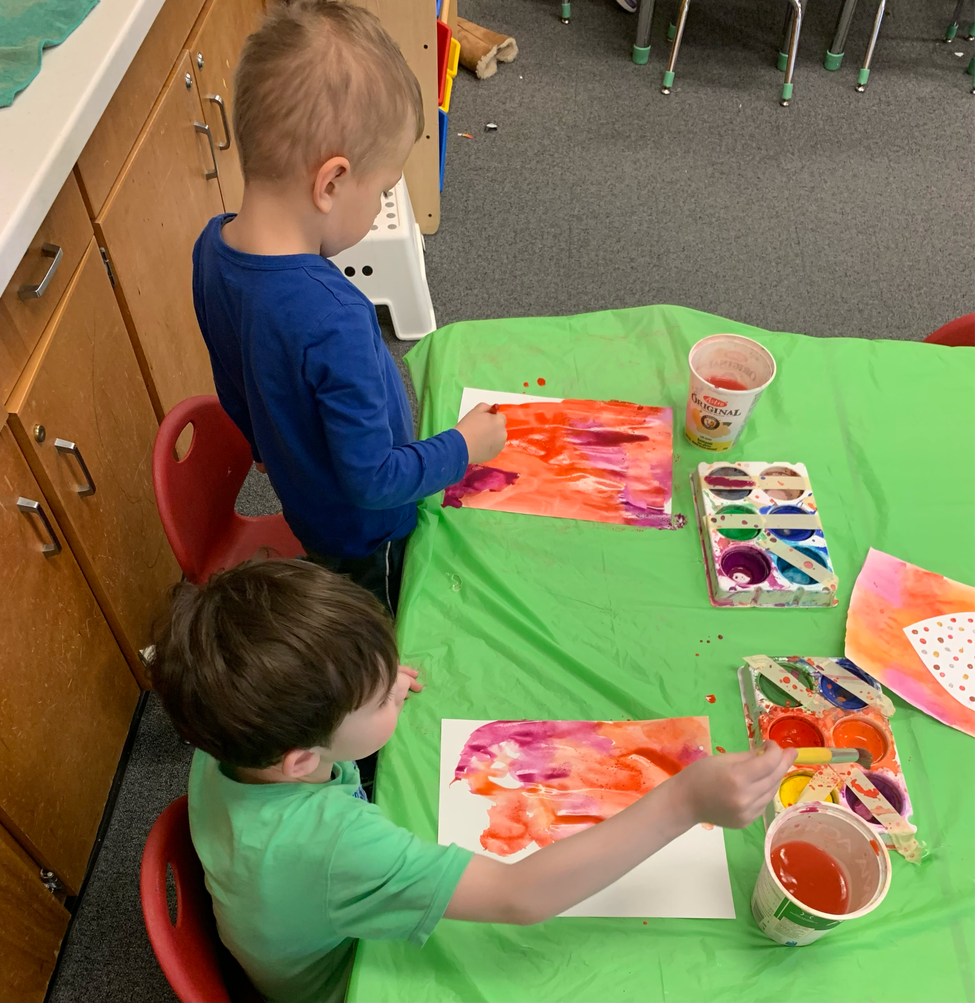
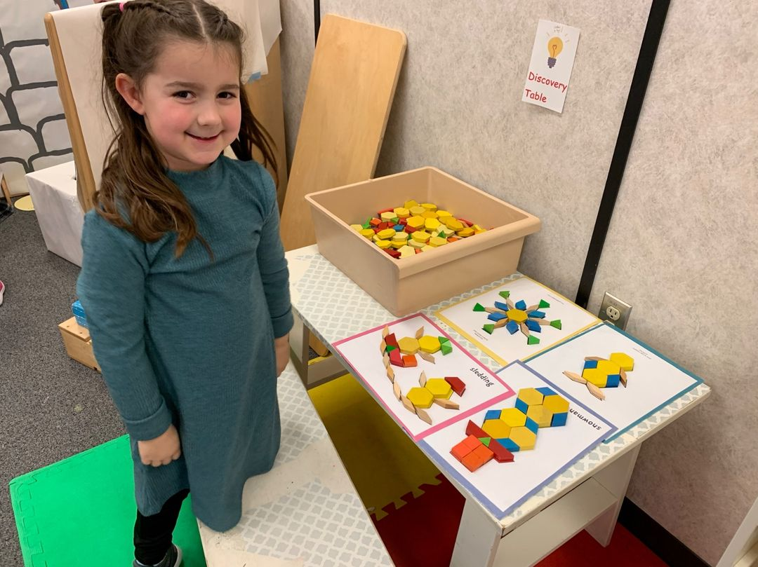
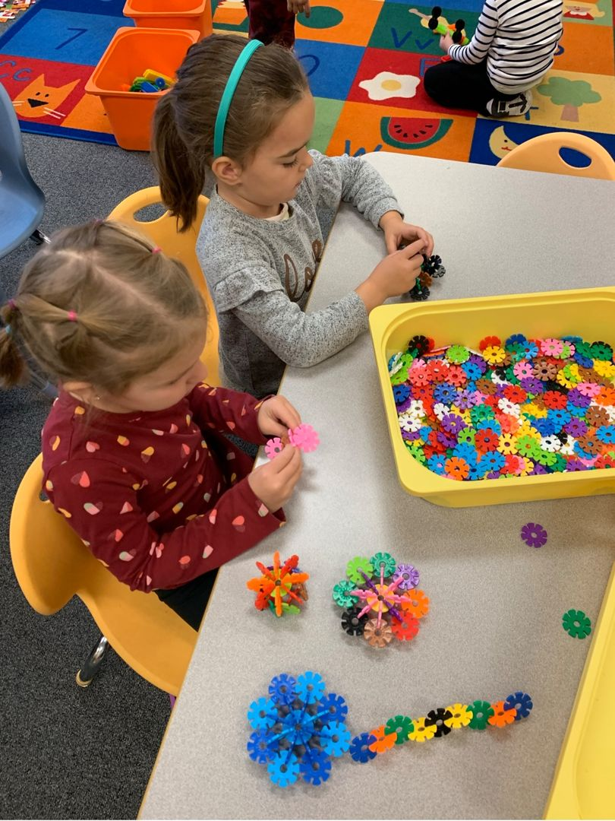
A Day in Kindergarten
Students engage in whole group, small group and one-on-one learning through structured and play based activities.
Centers are based on child interest and themes we are learning about.
Music, art, and games are used to build early literacy, early numeracy, and social skills.
Notes:
Megan
-We are a play based Kindergarten program. Intentionally planned play allows children to learn in a relaxed state of alertness. Through play students are learning literacy and numeracy skills,social skills, and independence. They are also able to express their own creativity and ideas.
-Students engage in small group, whole group and, one on one learning through structured and play based activities
-We have a variety of centres in our classroom that are based on interests, themes and learning outcomes
-Students have to opportunity to explore music art and games
-Kim and I work as a team and collaborate and do all our planning together. Our classrooms run very similarly. *Teacher depends on numbers and how our classes are structured
-All curriculum is covered in our half day program

Slide 6
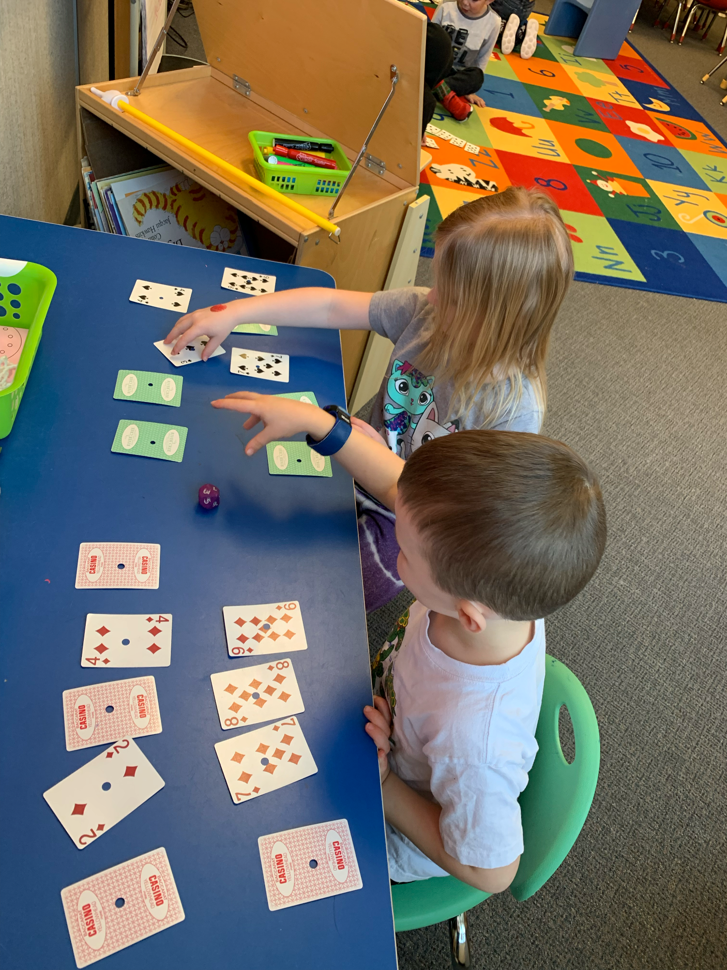
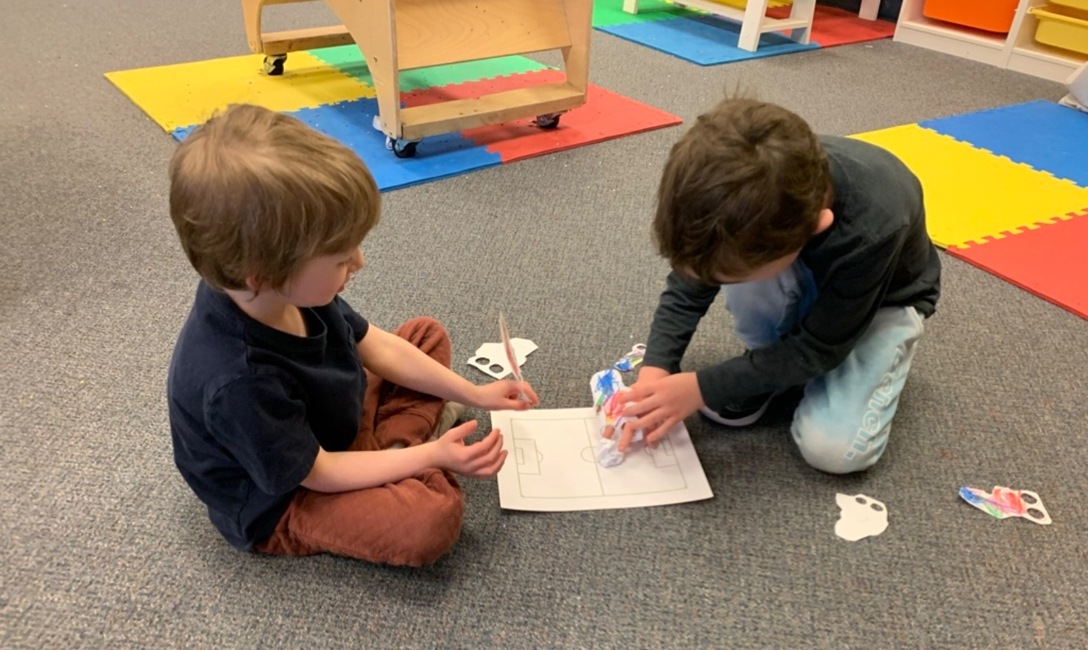
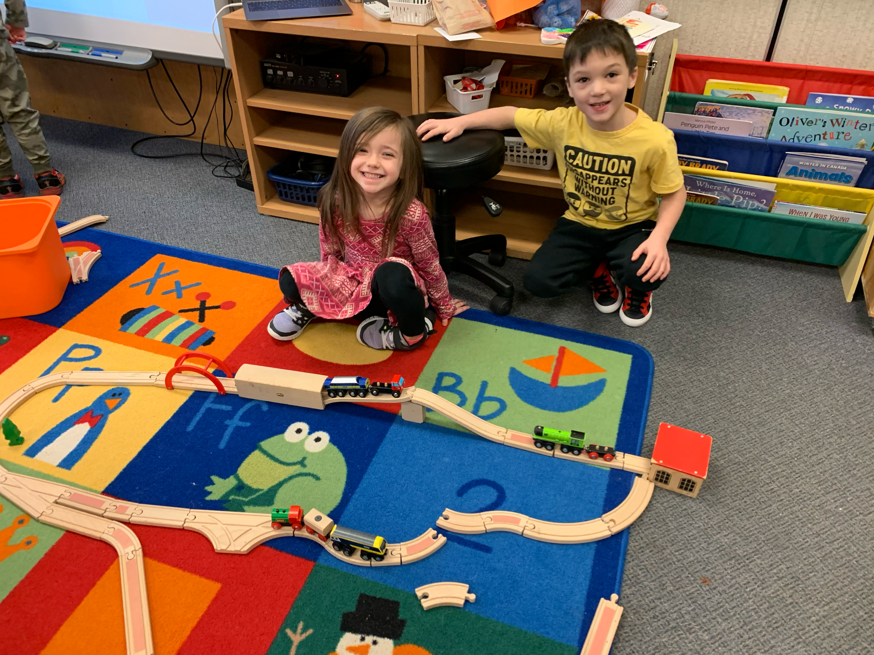
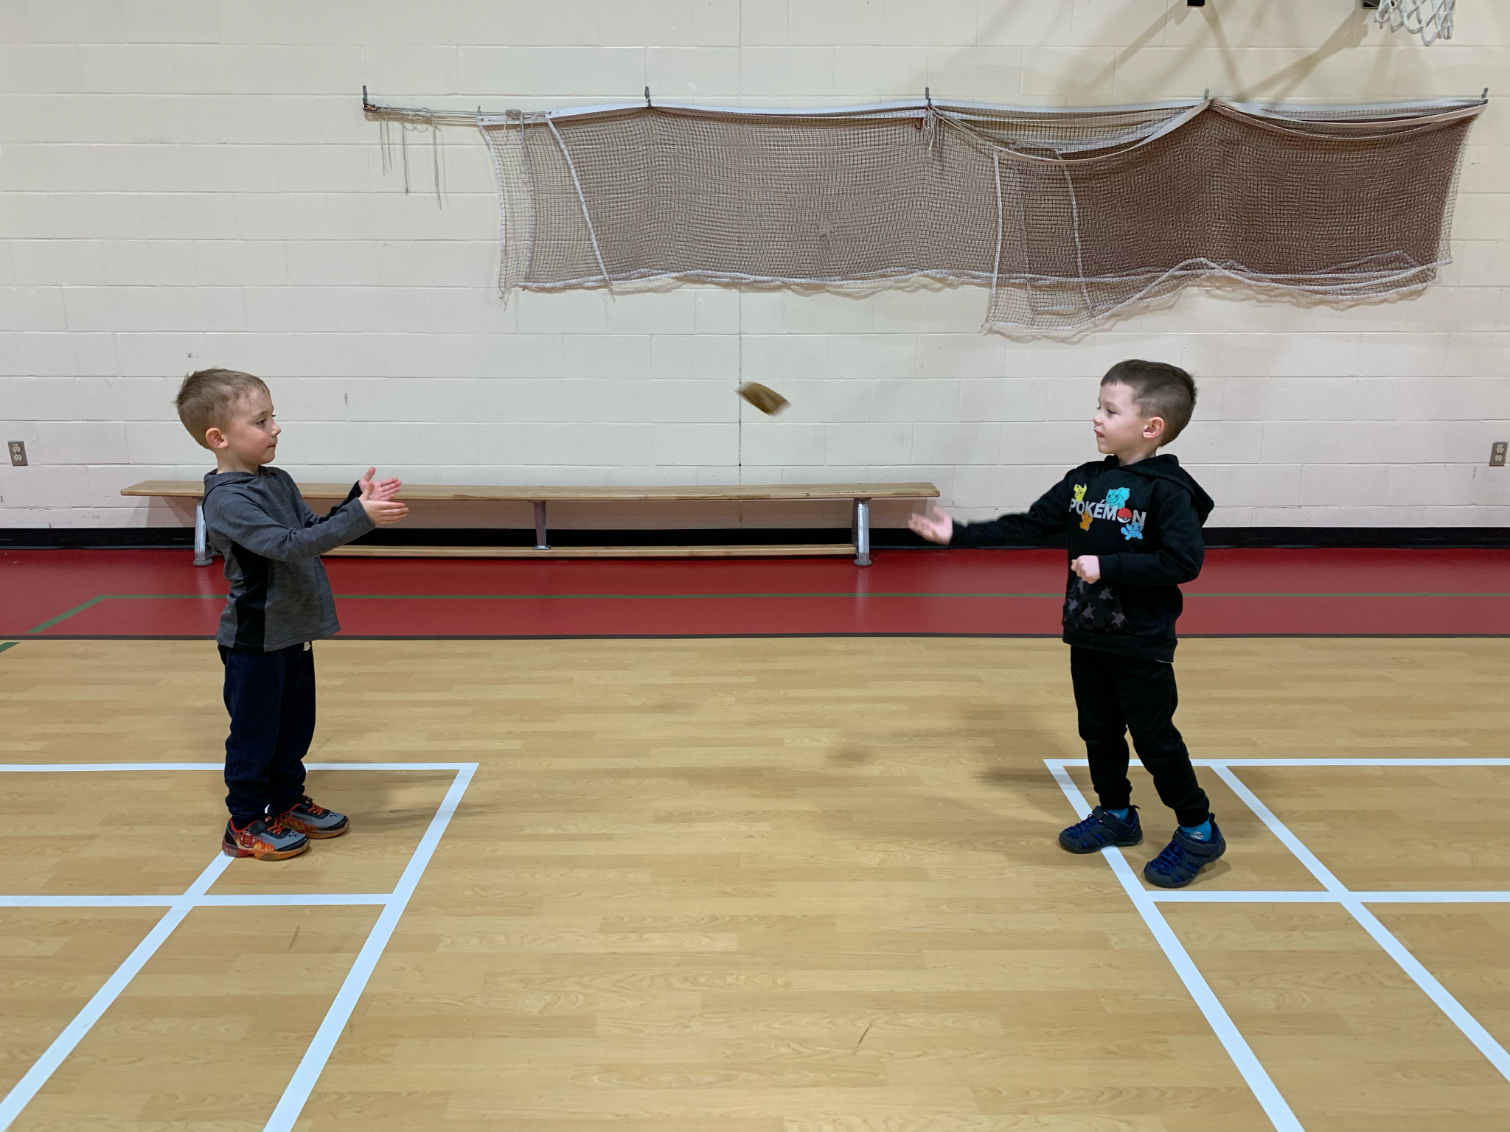
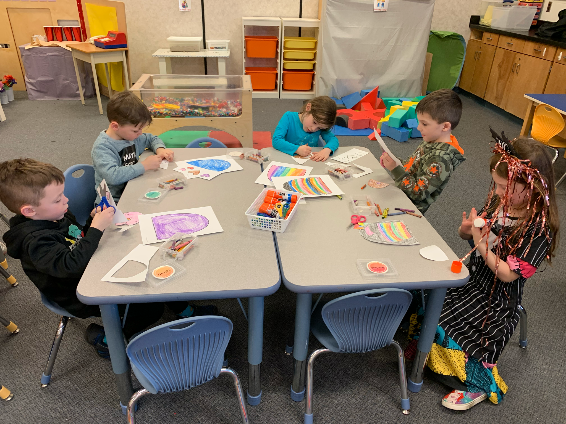
Full Day Kindergarten
Notes:
Megan
-Full day Kindergarten is an optional extension program. There is a monthly fee of $325 as it is not funded by the government
-Full day kindergarten allows for additional time to further develop skills and learning. Students have the opportunity to have lunch together, as well as recess. They also have additional time for phys ed., music and play

Slide 7
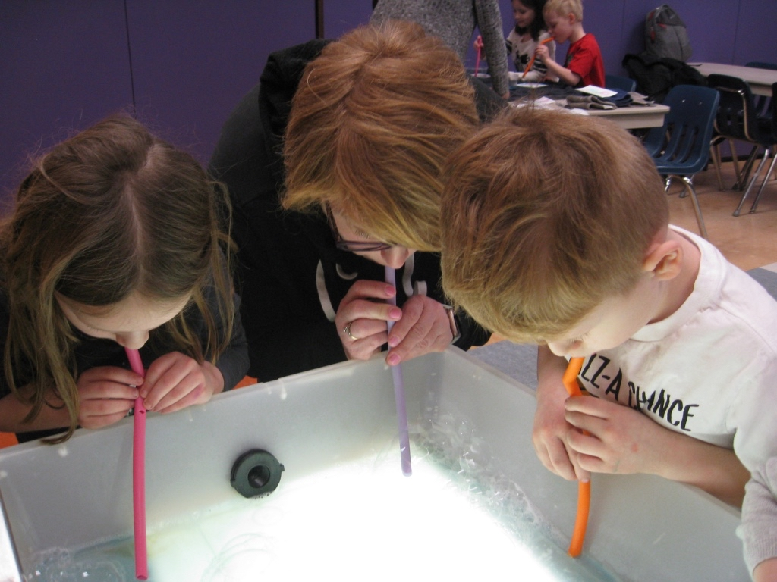
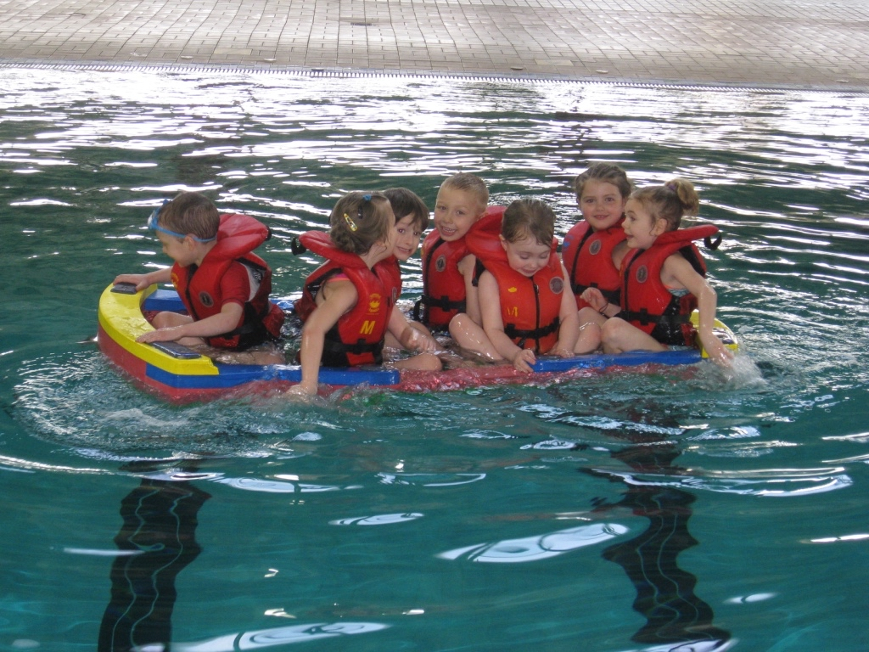
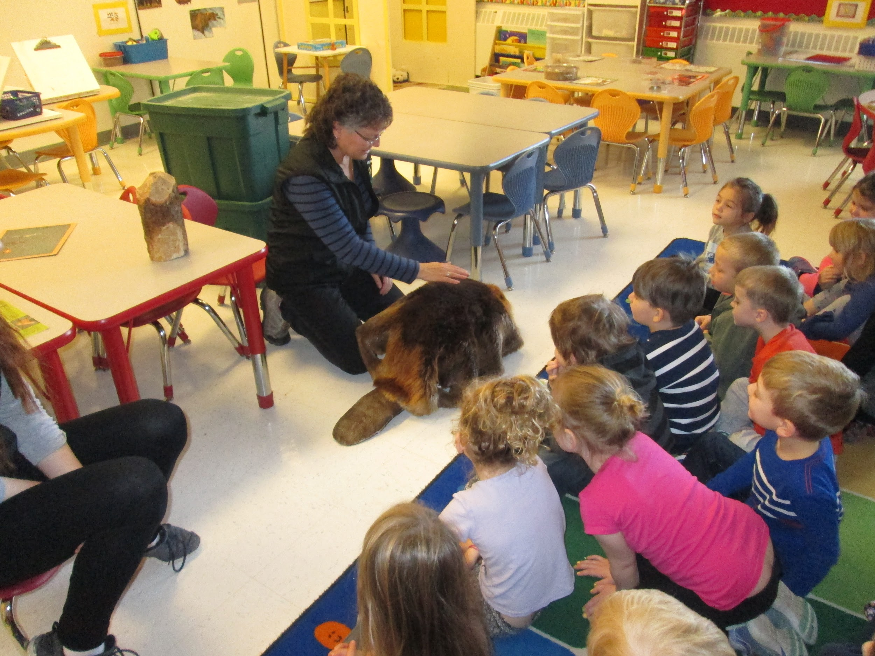
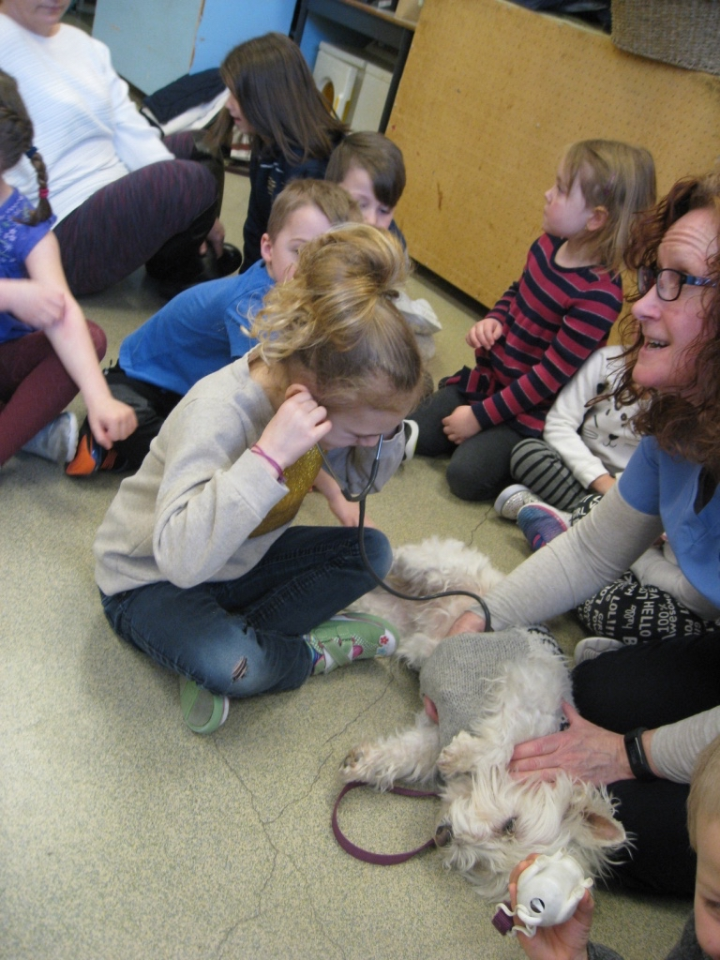
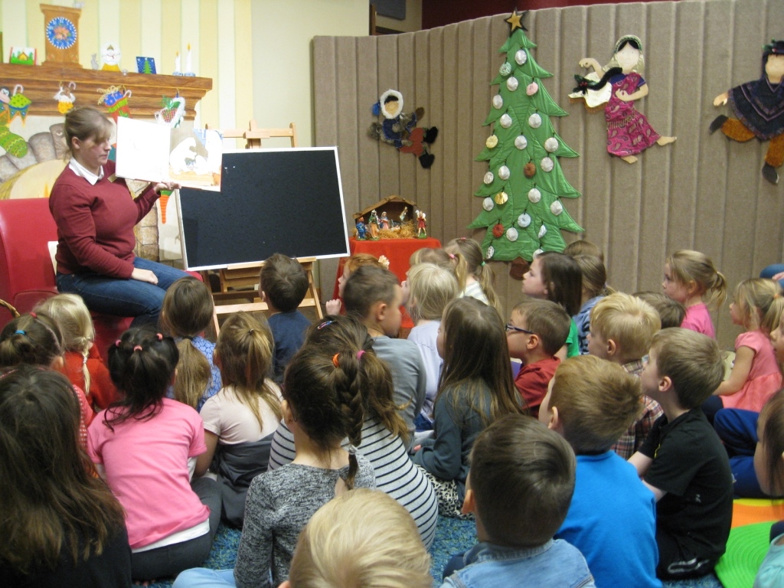
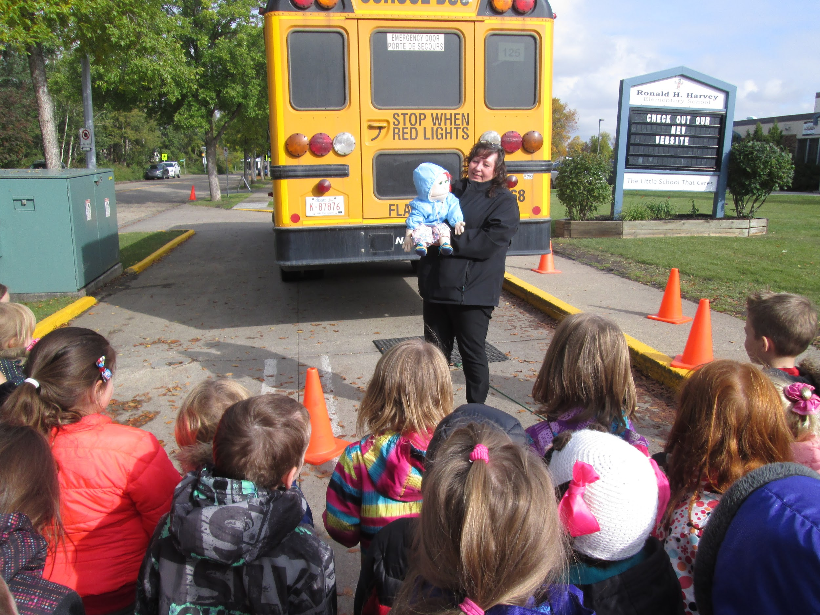
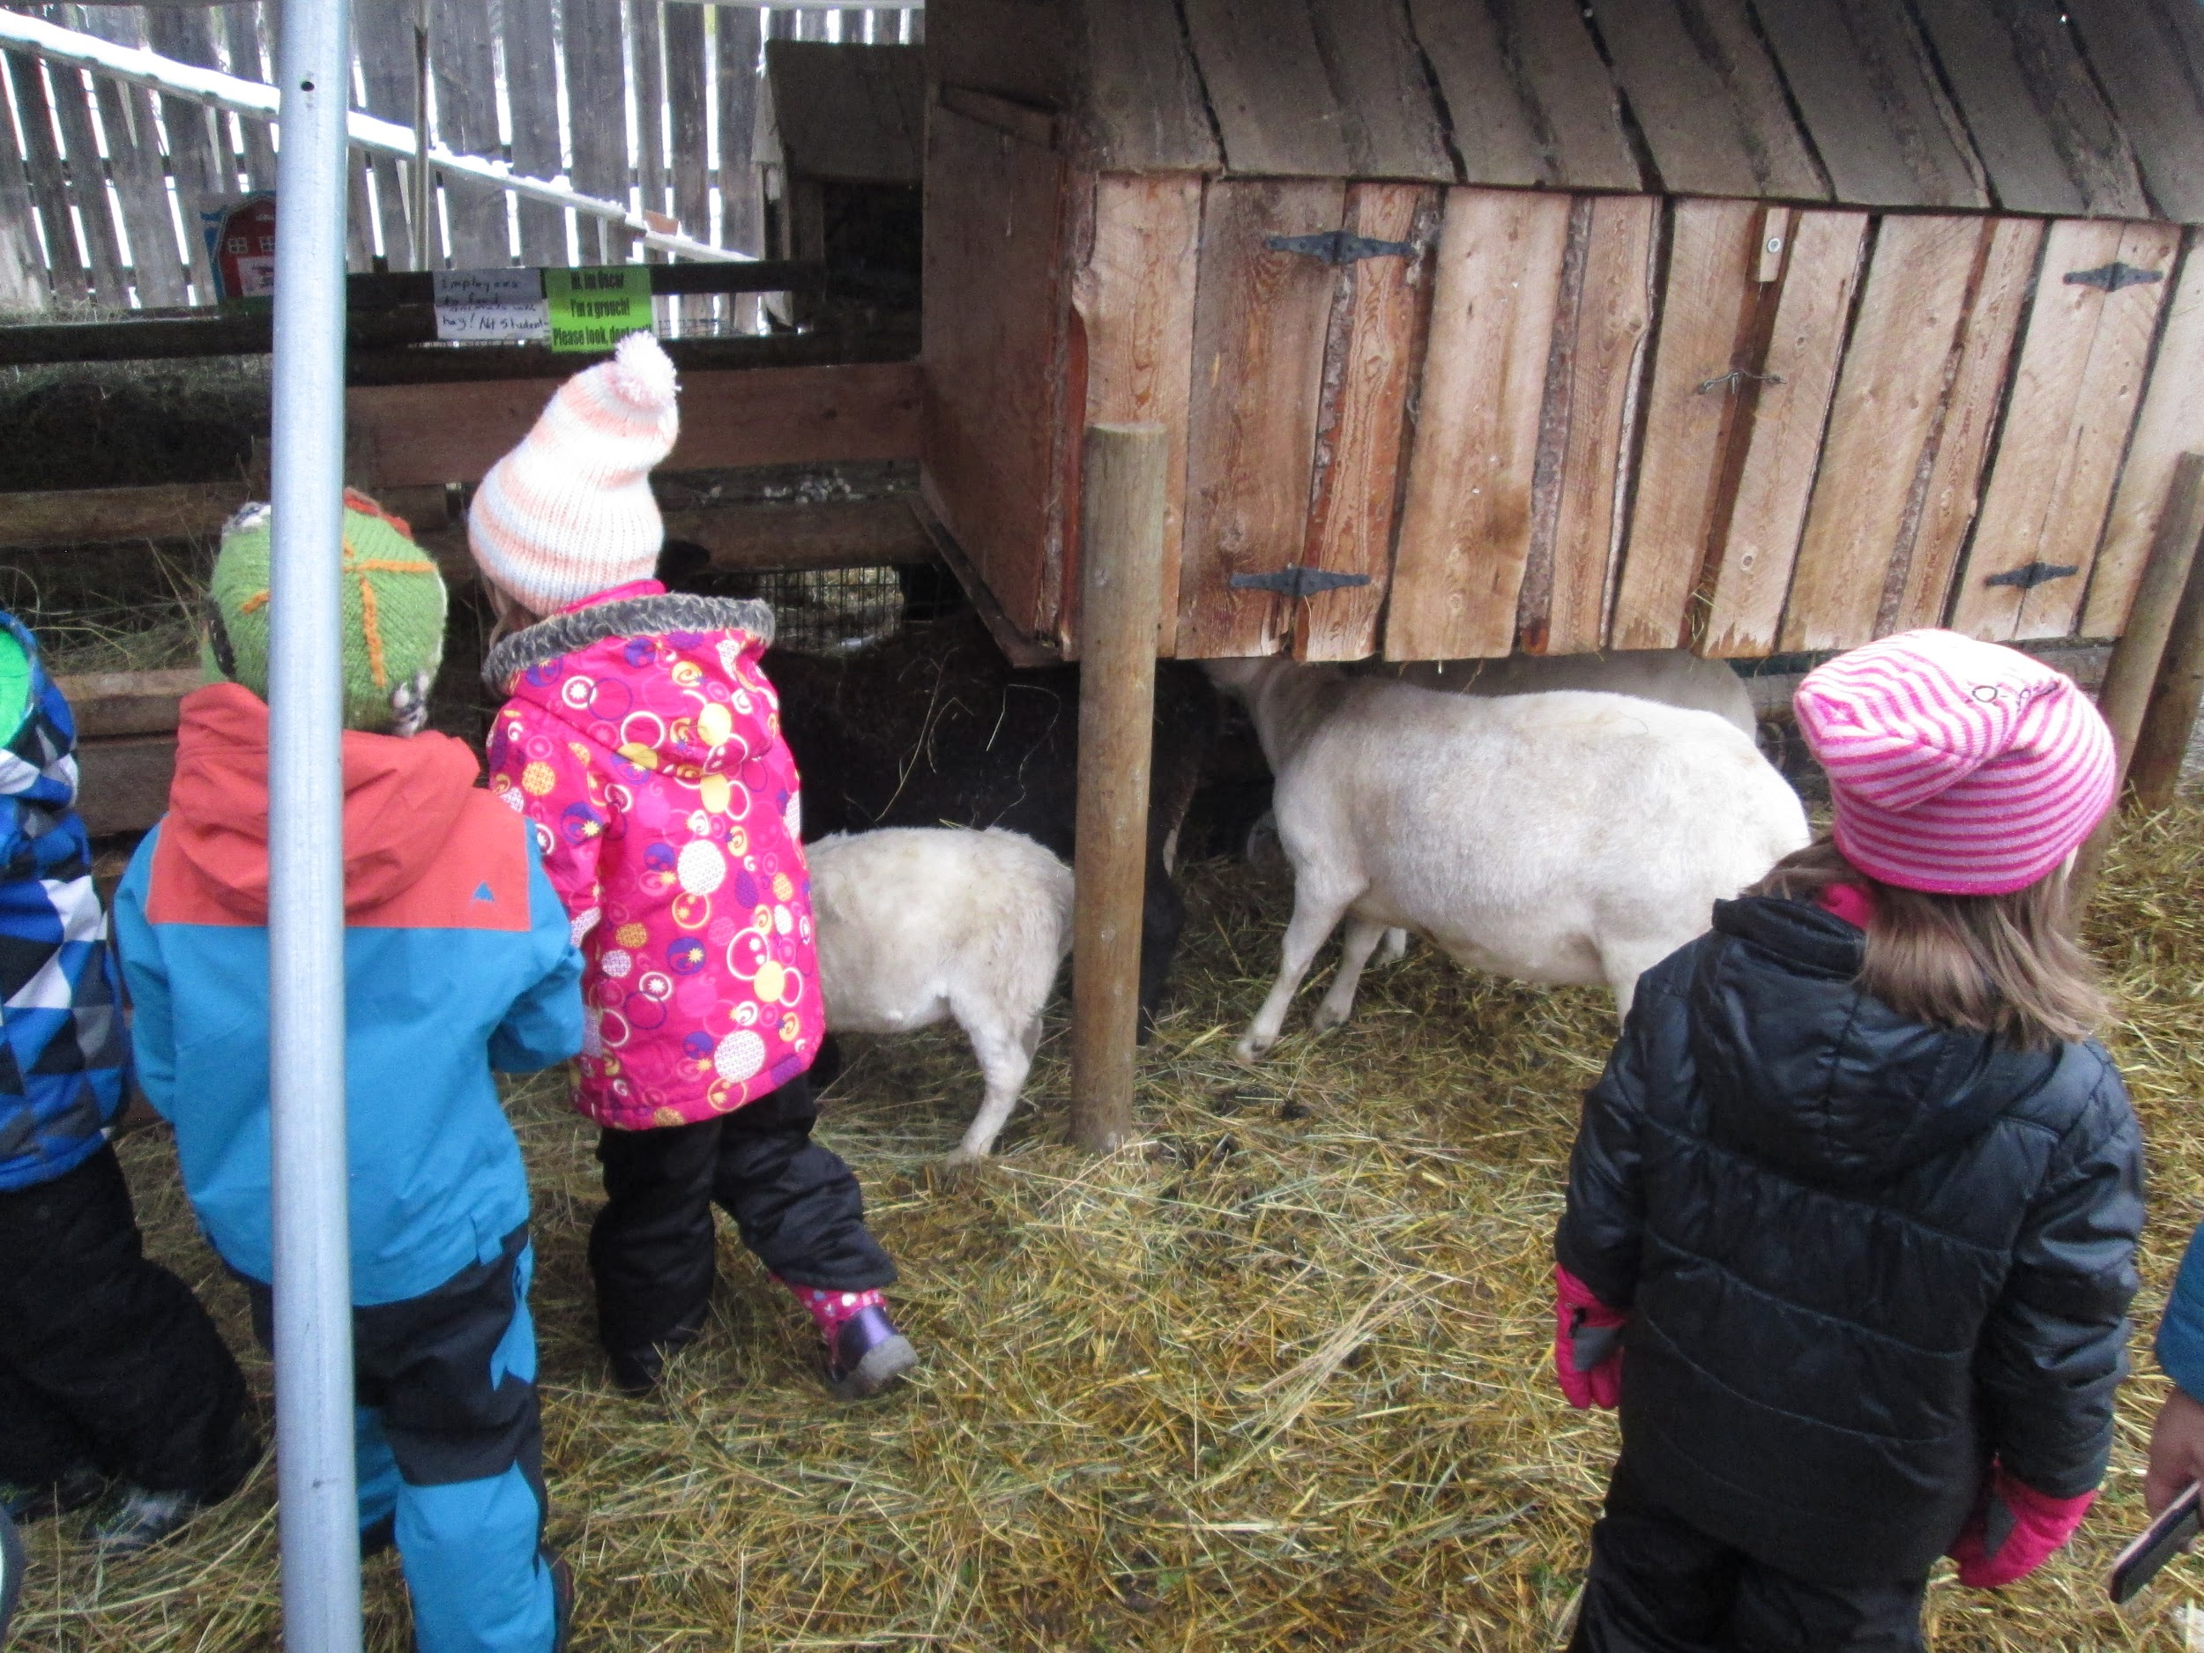
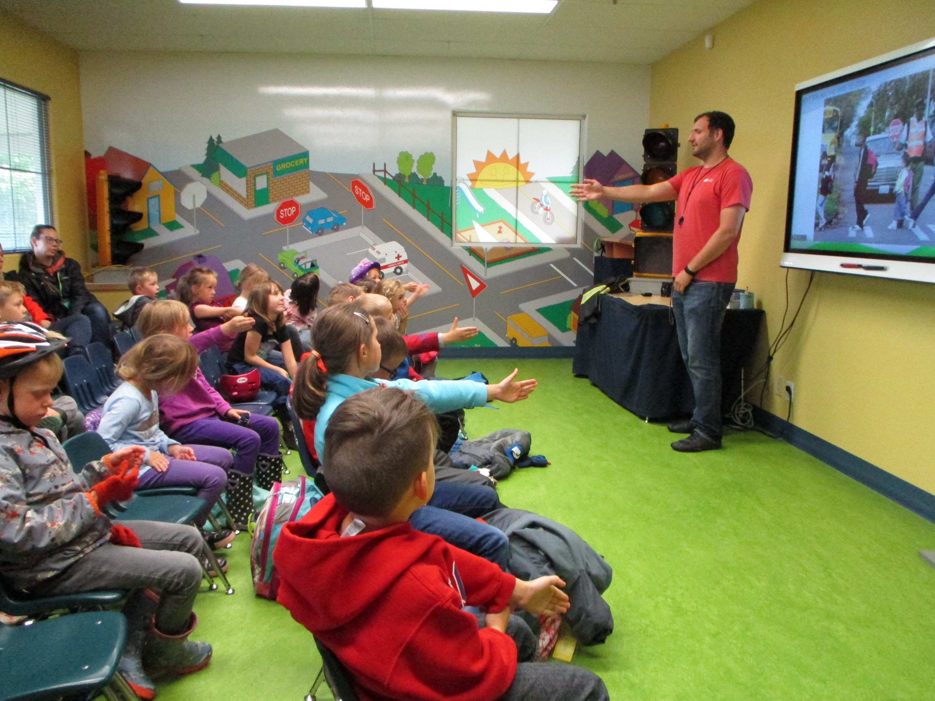
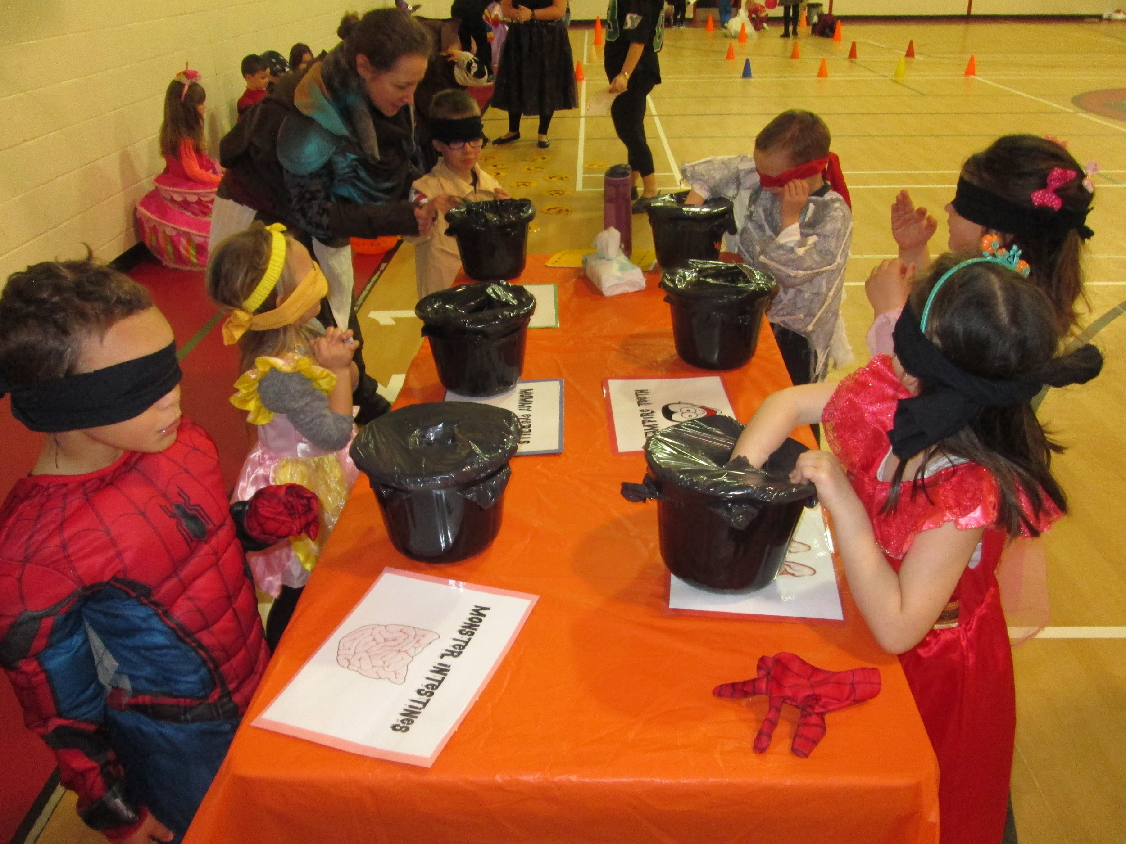
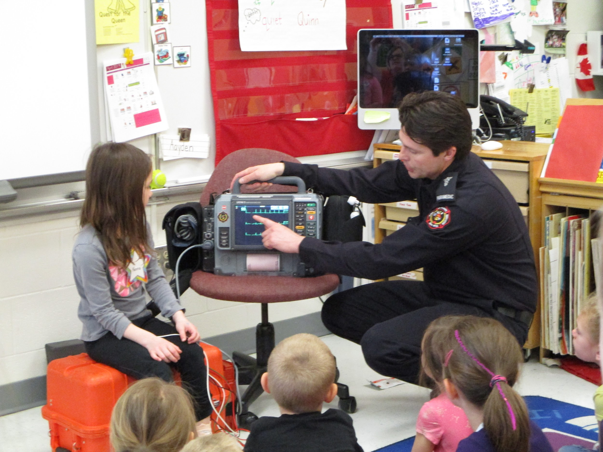
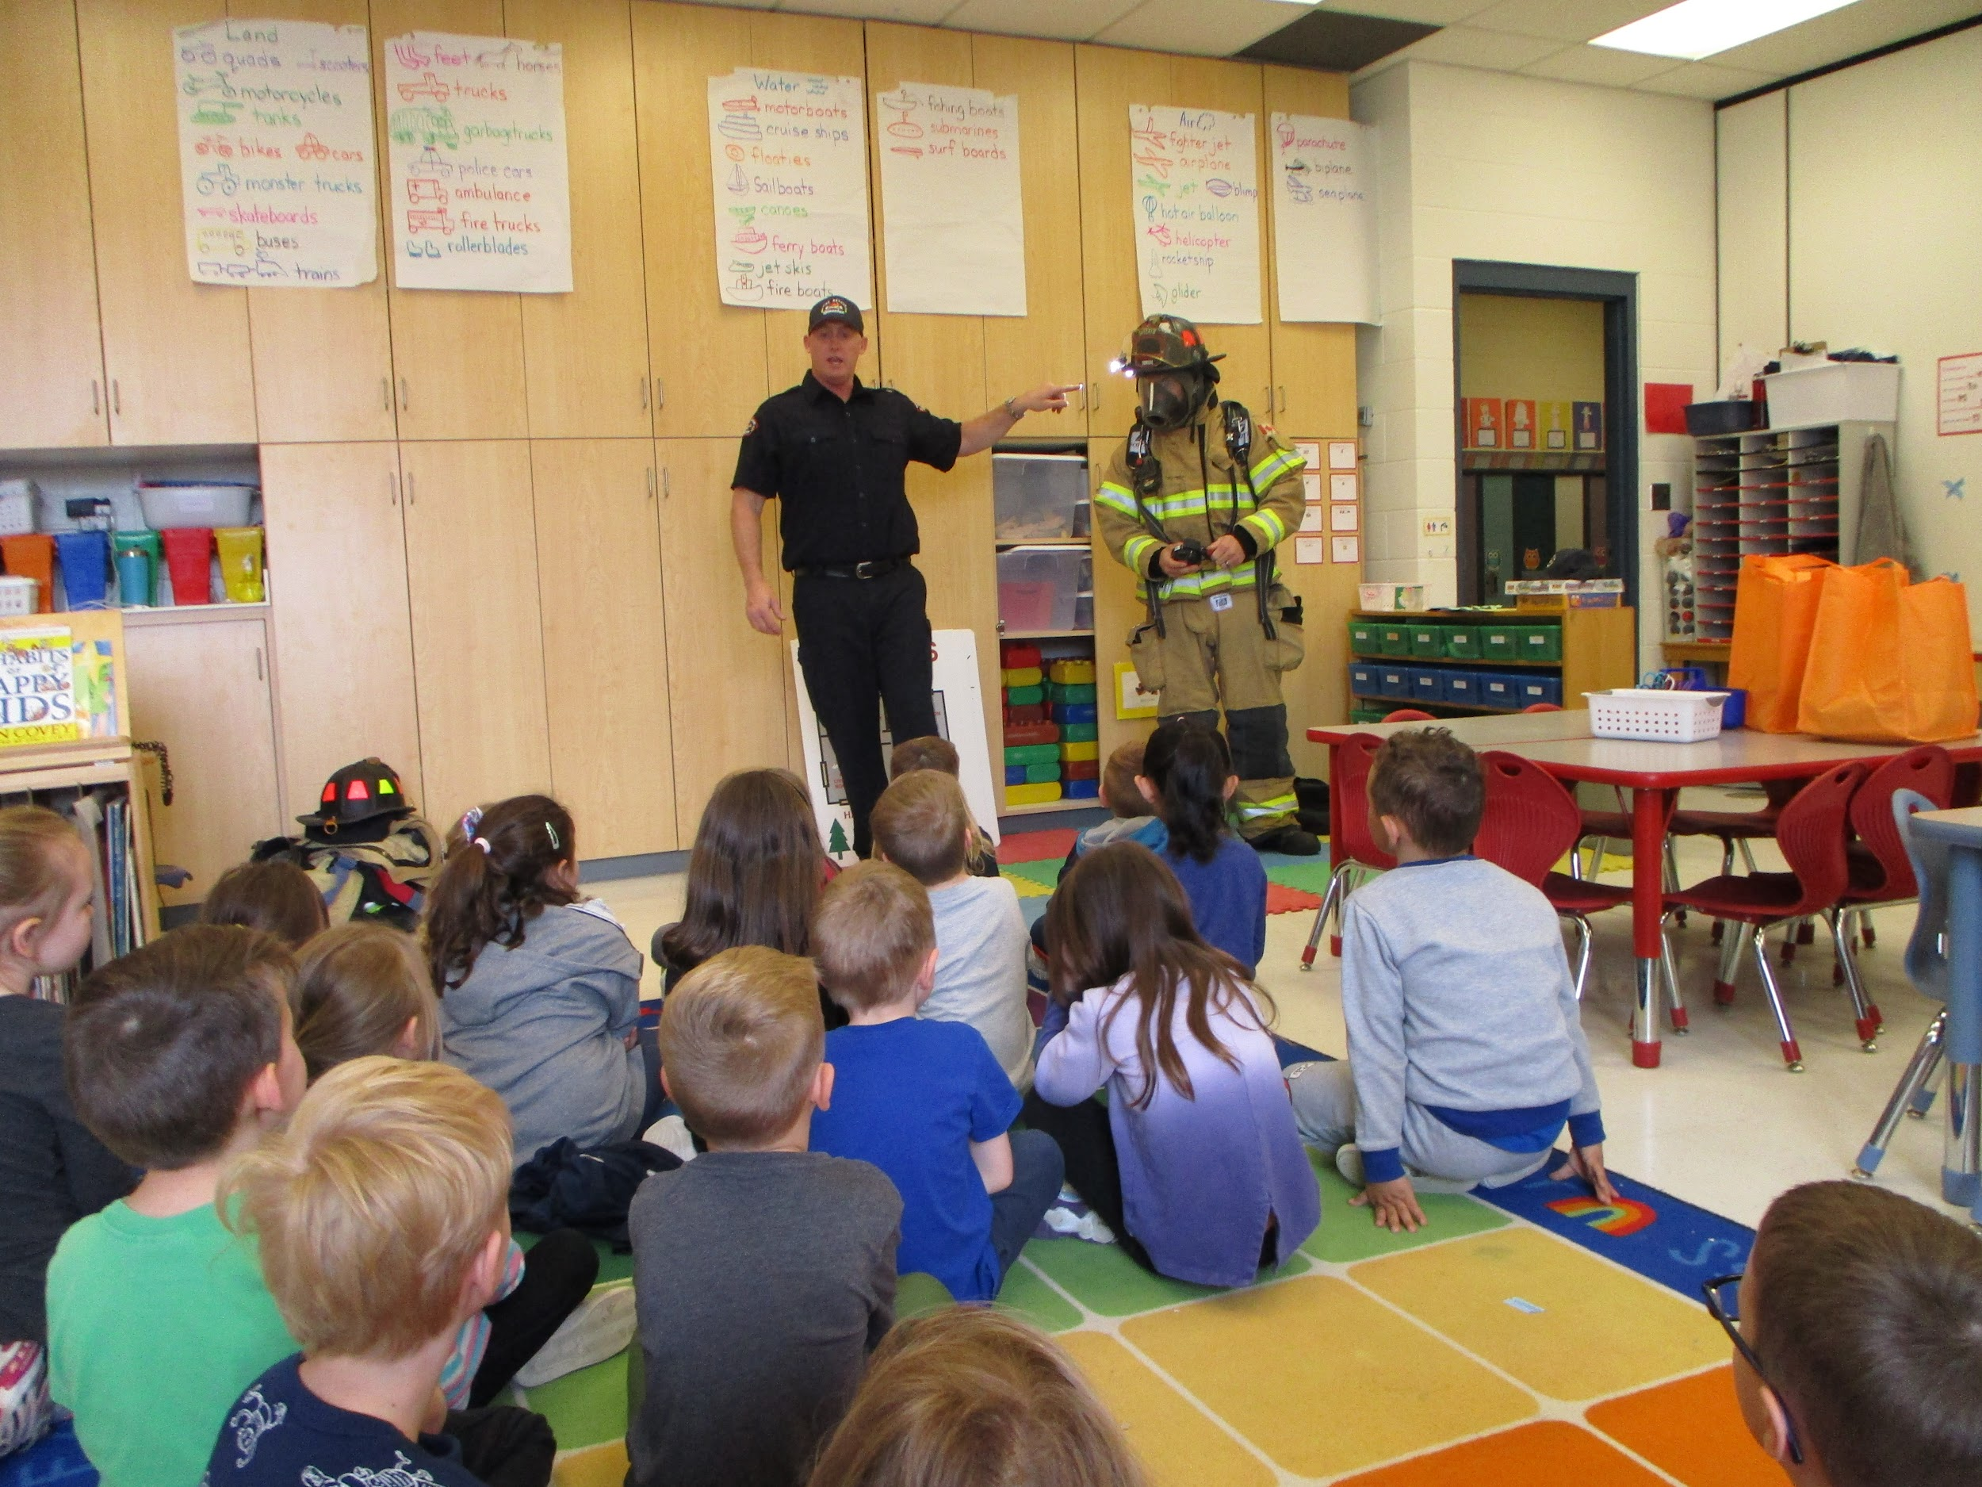
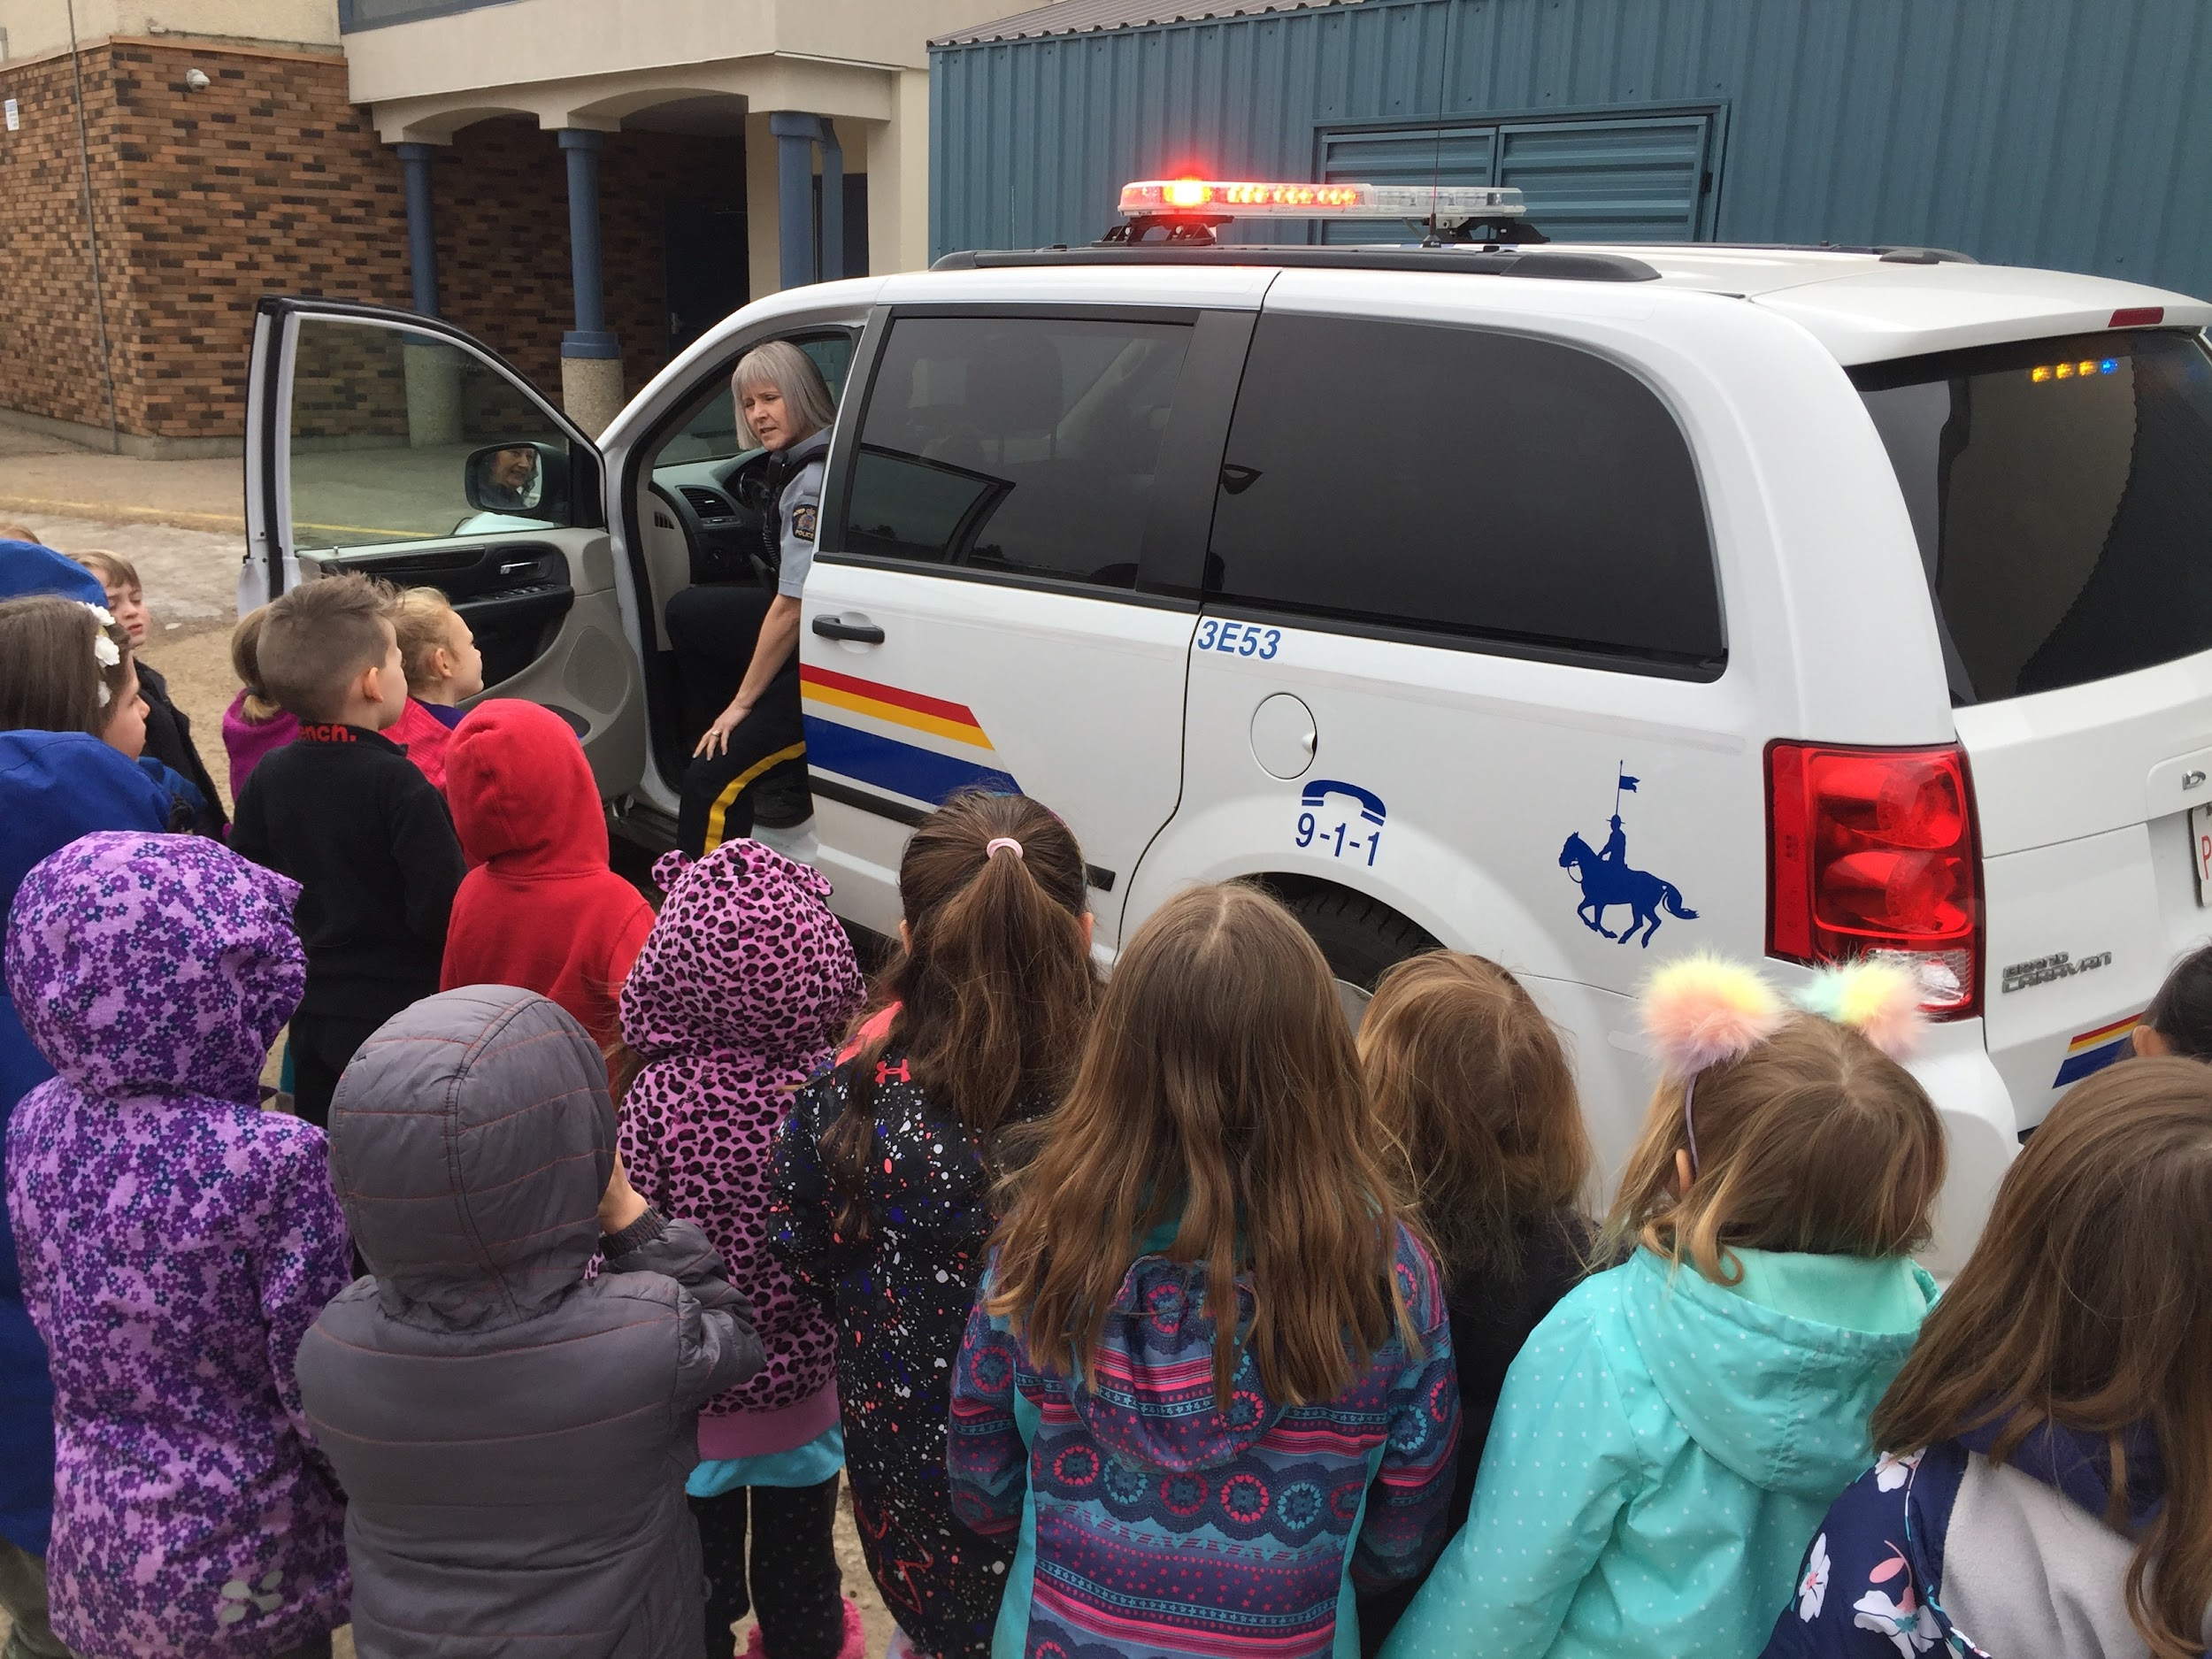
Field Trips and In Class Events
Venturing out into the community as well as having special guests in the classroom offers unique learning experiences for our students. Our classes have many opportunities throughout the year to engage in a variety of learning environments.
Notes:
Kim - We try to do about one field trip a month. Sometime we have specials guest and sometimes we venture out into the community. Some examples of field trips we have been on include the Library, safety city, Fountain park pool, gymnastics, the space and science center and the zoo.

Slide 8
Kindergarten Fees
All Kindergarten students - $220 activity fee for the year
Full Day Students - an additional $325 per month
Notes:
Megan - the activity fee covers field trips, crafts and kinder cooking supplies.

Slide 9
Kindergarten Start and End TImes
Morning Kindergarten
School day begins at 8:55 a.m. and ends at 11:40 a.m.
Afternoon Kindergarten
School day begins at 12:40 p.m. and ends at 3:25 p.m.
Full-Day Kindergarten
School day begins at 8:55 a.m. and ends at 3:25 p.m.
Notes:
Kim

Slide 10
Families As Partners
There are many opportunities throughout the school year to partner in the classroom, on field trips or with take home projects.
These may include:
Kinder Cooking
Scrapbooks
Theme Based Projects
Sharing Expertise
Playdough
Notes:
Megan
-We are so grateful that you are here today. We strongly value our relationships with families and we are partners in your child’s Kindergarten journey. We recognize that this might be a new experience for you and your child. Please know we are here to support you and love you through it all. We love having family members join us and there are many opportunities throughout the school year for this to happen. Such as Kinder cooking, scrapbooks, theme based projects, sharing your epertises adn making playdough.

Slide 11
Before and After School Care
At Ronald Harvey there is out of school care provided by SIGIS Childcare Society. Visit their website for more information.
Notes:
Kim - offer before and after school care as well as half day care for students if you have questions about child care please contact SIGS.

Slide 12
Transportation
Bussing may be available for your child. Please contact district office at
(780) 460-3712, ask for transportation, or click on the bus to get to their link!
Notes:
Kim

Slide 13
Next Steps
Test Drive - Friday, May 16
*Please call or email Monica Ellison to book your time*
780-459-5541 monica.ellison@spschools.org
Registration
Email in August
Small Group Orientation
Tuesday, September 2
Wednesday, September 3
Thursday, September 4
Notes:
Megan - We are starting to take names for Test drive on Monday Feb 10th.
Please register as soon as possible so we have an accurate account of the number of students joining us this fall.

Slide 14
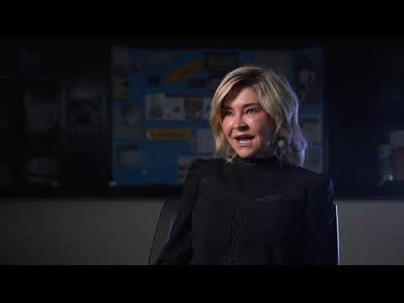
Kindergarten Readiness
Notes:
Megan Video Resources - access them online through our website
There is an information sheet regarding speech language screens that can be can be completed prior to you child coming into kindergarten. They are available on the table at the entry of the gym if you are interested and have not picked one up yet.

Slide 15
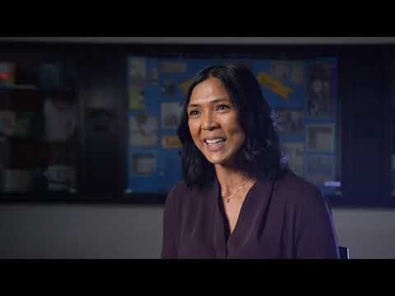
Kindergarten Supports

Slide 16
Please contact us with any questions you may have!
School Phone: 780-459-5541
Matt Tripp
matthew.tripp@spschools.org
Kelly Hauptman
kelly.hauptman@spschools.org
Megan Sneddon
megan.sneddon@spschools.org
Kim Miller
kimberley.miller@spschools.org
Notes:
Megan - please contact us if you have any questions.

Slide 17
We’d love to see you in the fall!
Register Now!
Notes:
Matt - Any questions?

