Slide 1
Ronald Harvey Kindergarten

Slide 2
A Tour of Ronald Harvey School &
Our Kindergarten Program

Slide 3
How old does my child need to be to register for kindergarten?
2023/2024 School Year
Children must be at least 4 yrs 8 months of age but less than 6 years of age on Sept. 1, 2023 to register for Kindergarten. (They must turn 5 on or by Dec. 31, 2023)

Slide 4
Kindergarten Learning
The kindergarten program is made up of seven areas of child development.
Visit LearnAlberta to explore these areas of development through their
Early Numeracy
Early
Literacy
Citizenship & Identity
Child Development
Creative Expression
Environment & Community Awareness
Physical Skills & Well-being
Personal & Social Responsibility

Slide 5
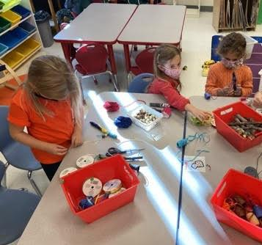
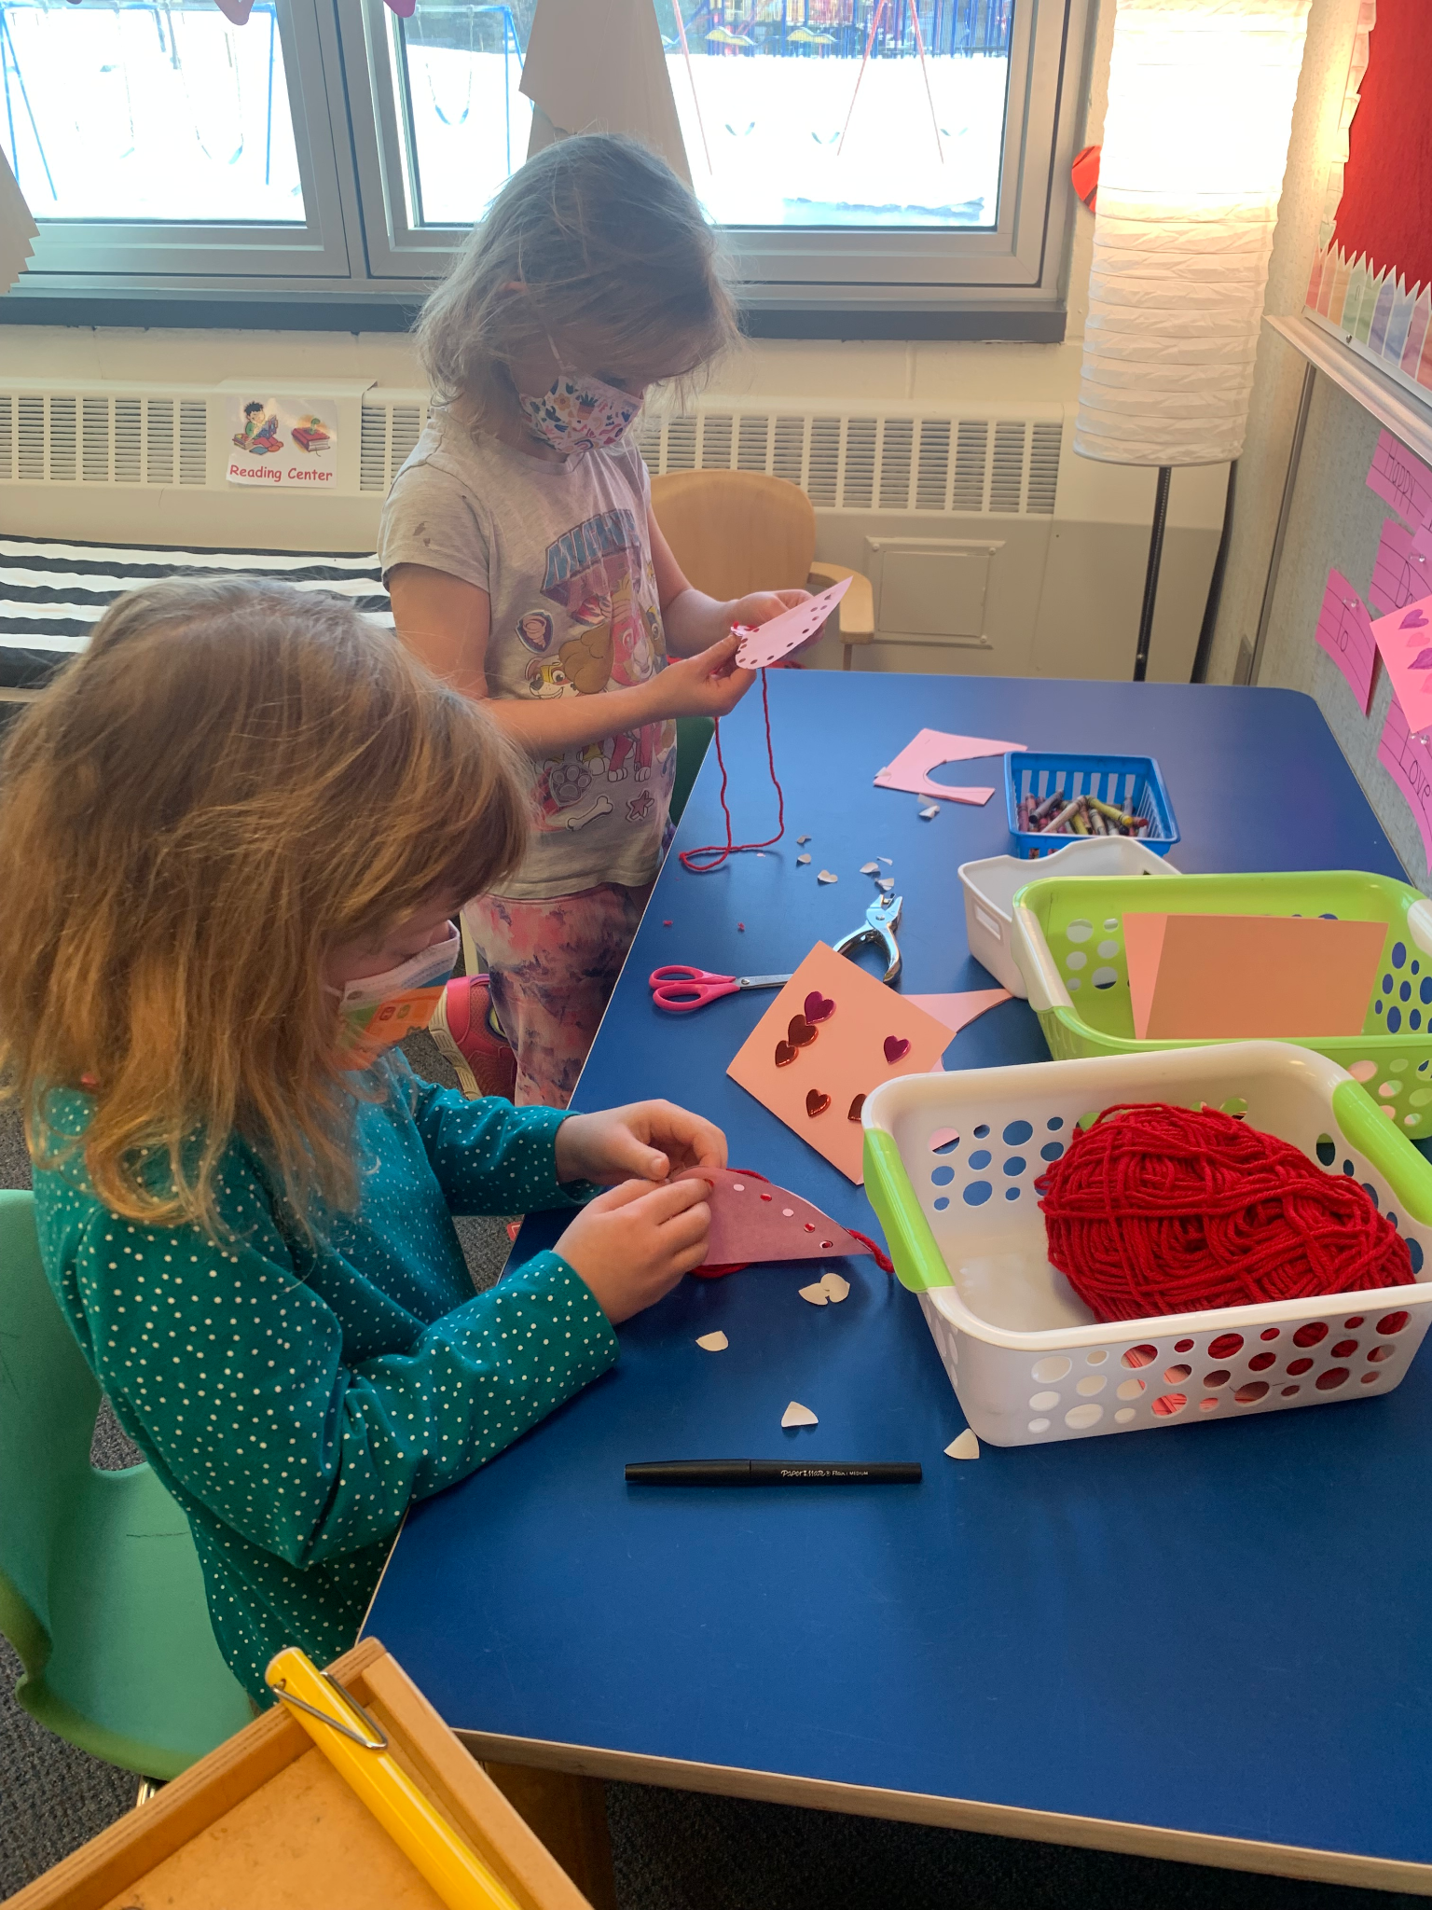
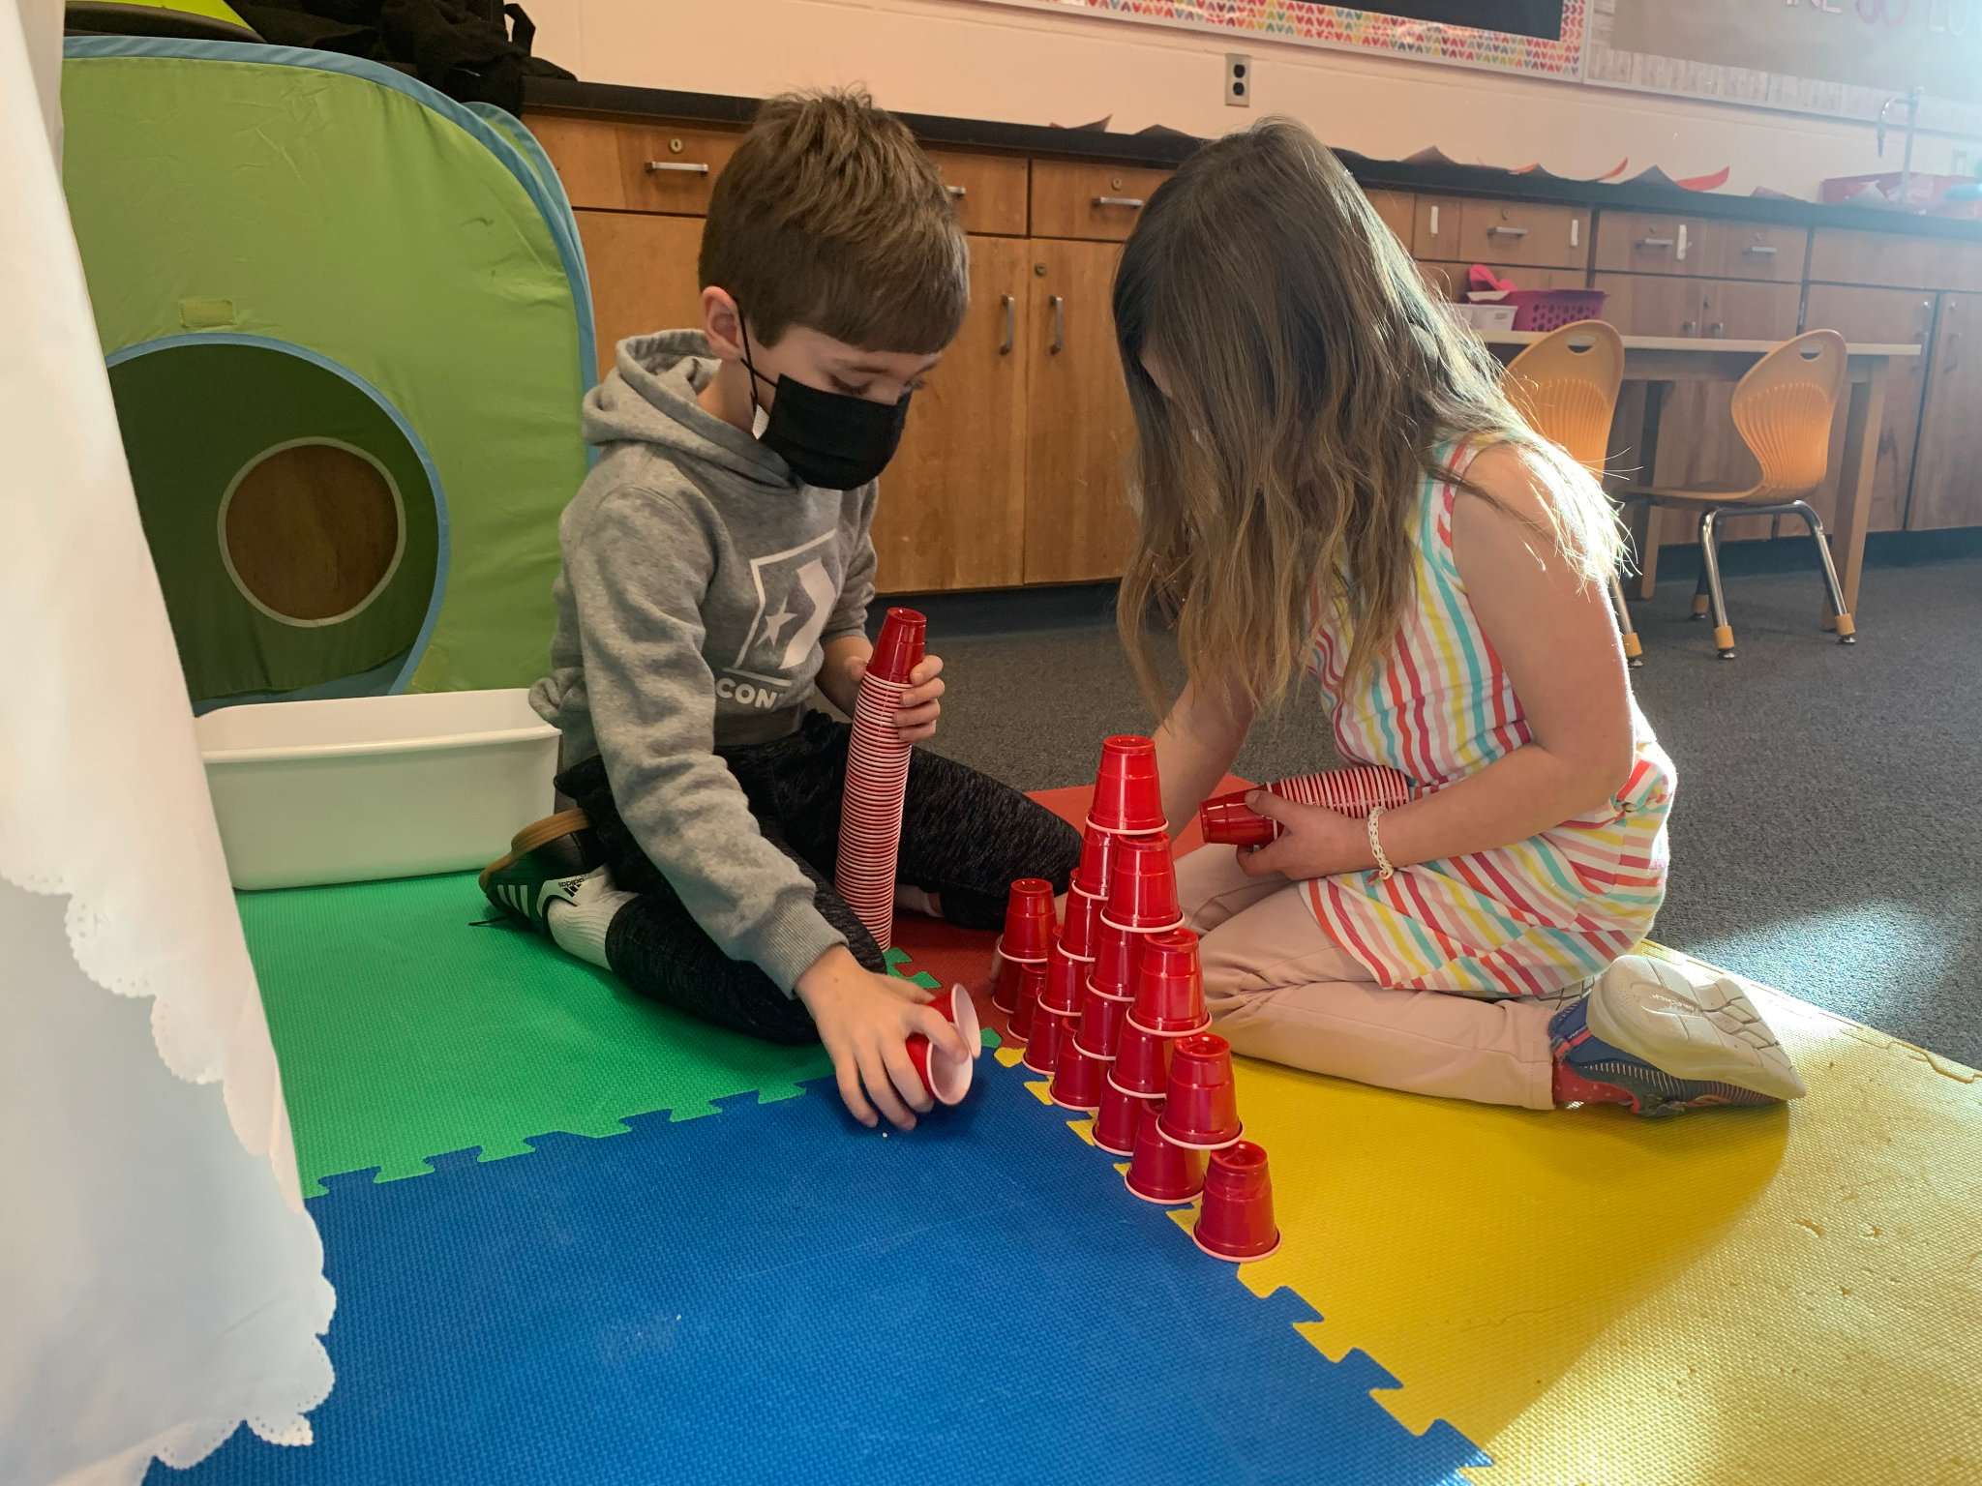
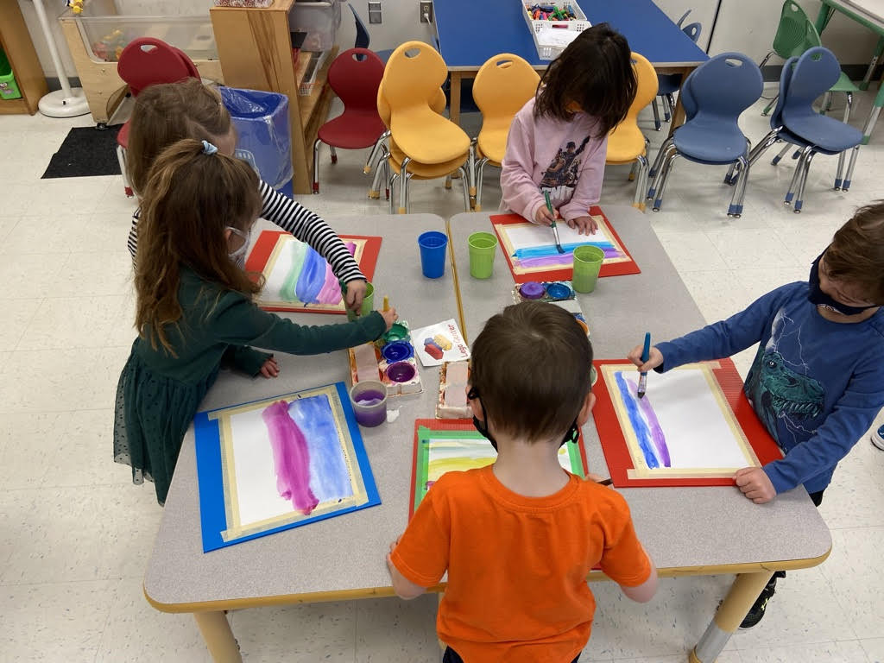
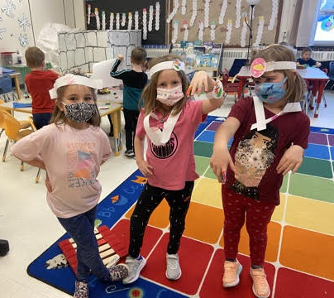
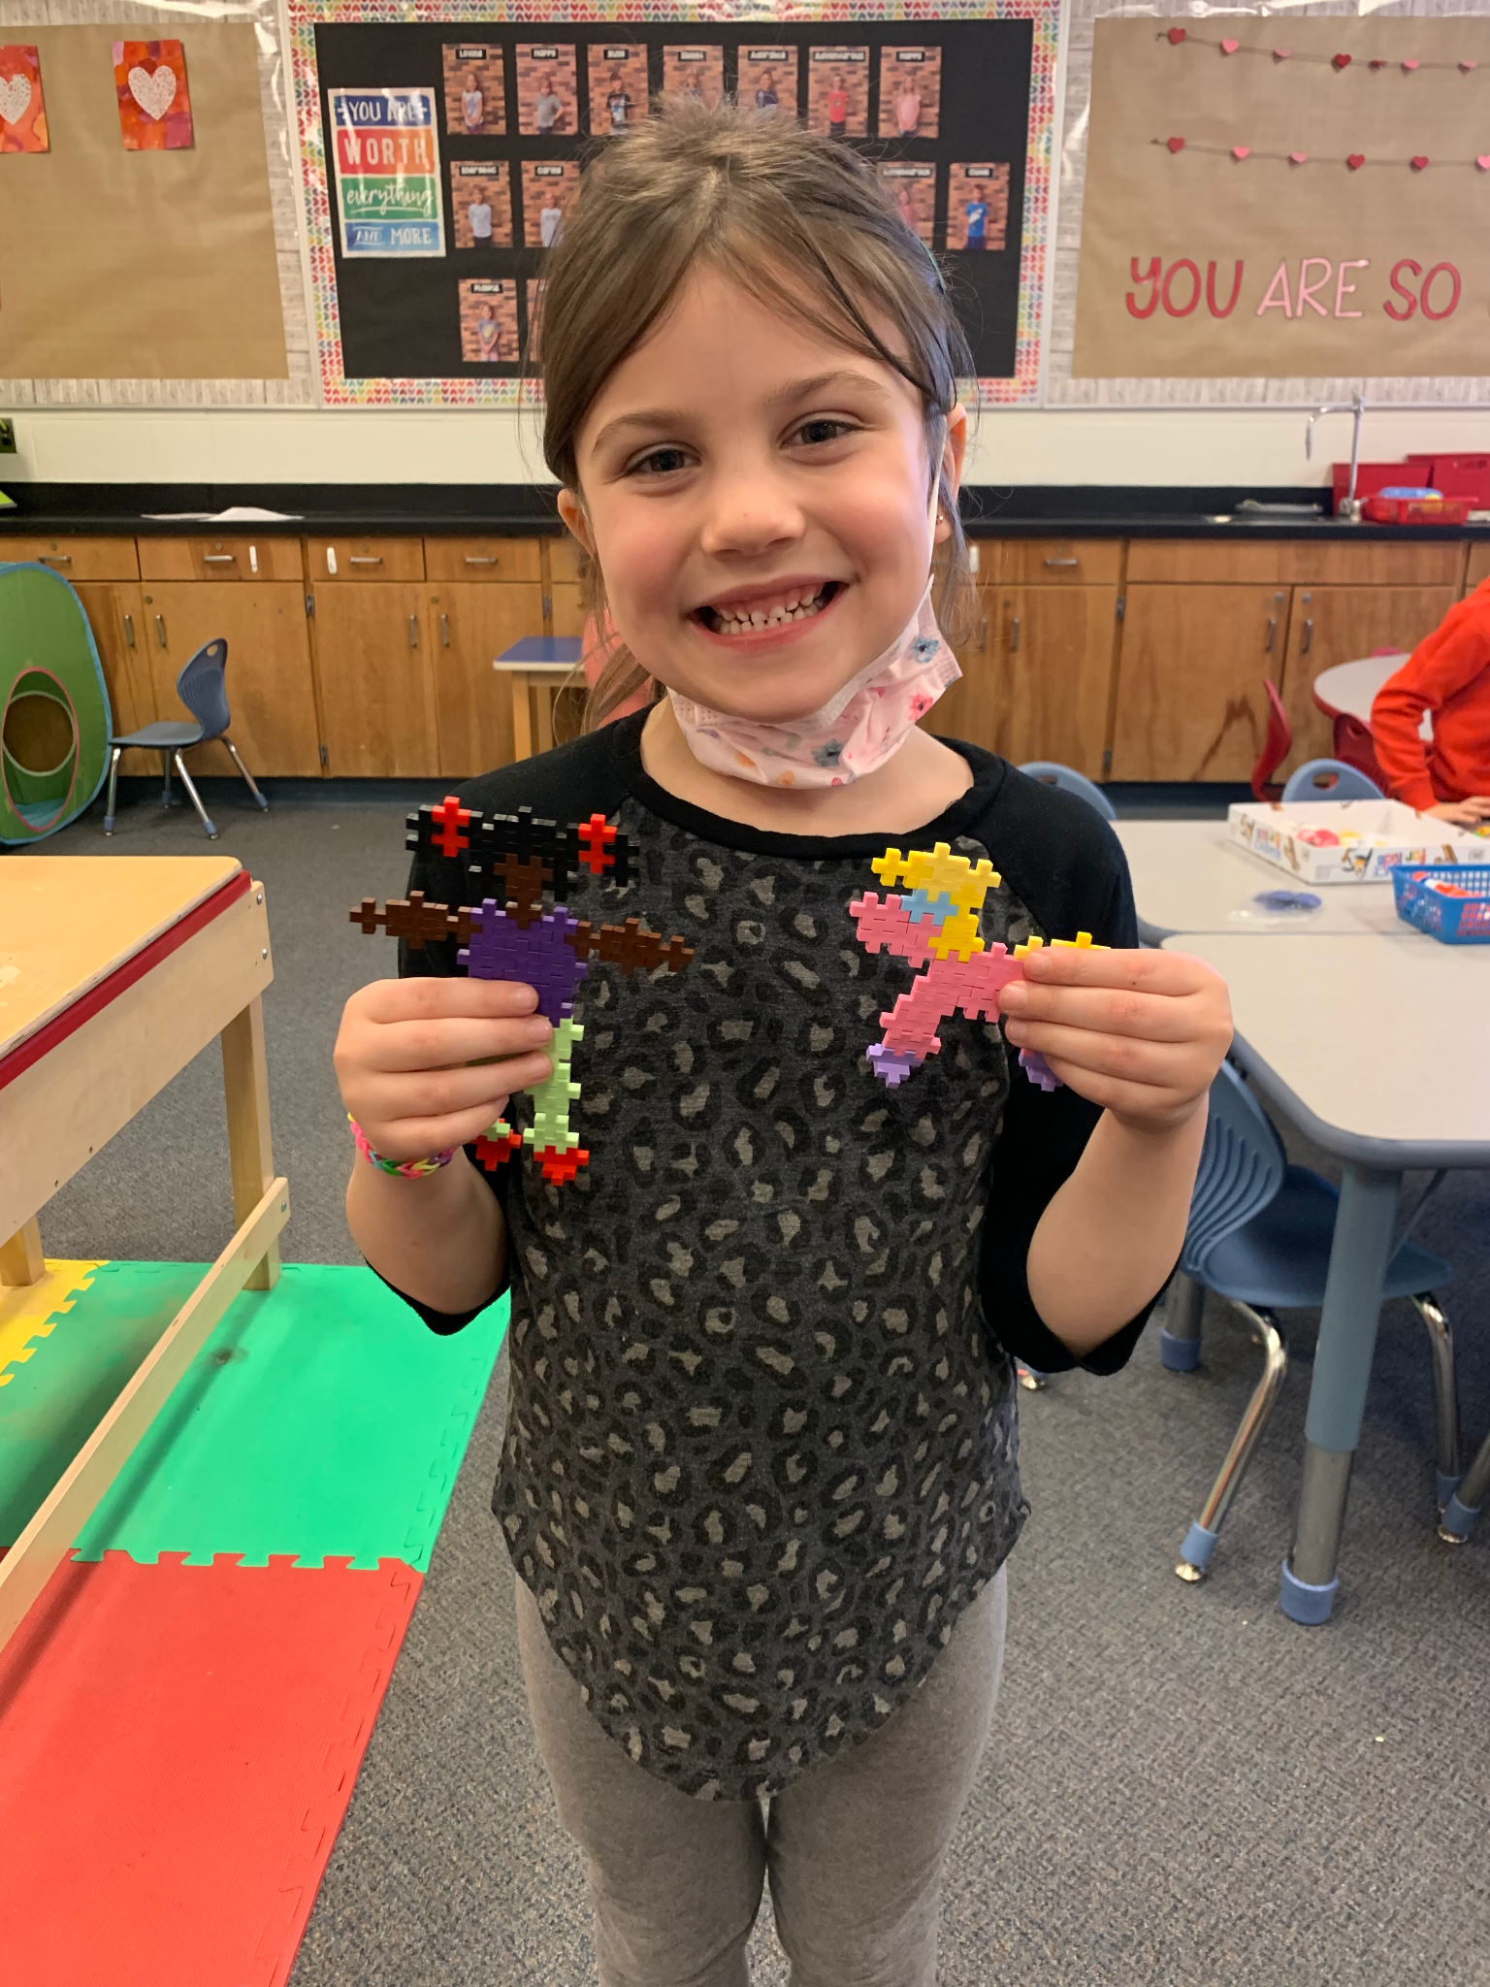
A Day in Kindergarten
Students engage in whole group, small group and one-on-one learning through structured and play based activities.
Centers are based on child interest and themes we are learning about.
Music, art, and games are used to build early literacy, early numeracy, and social skills.

Slide 6
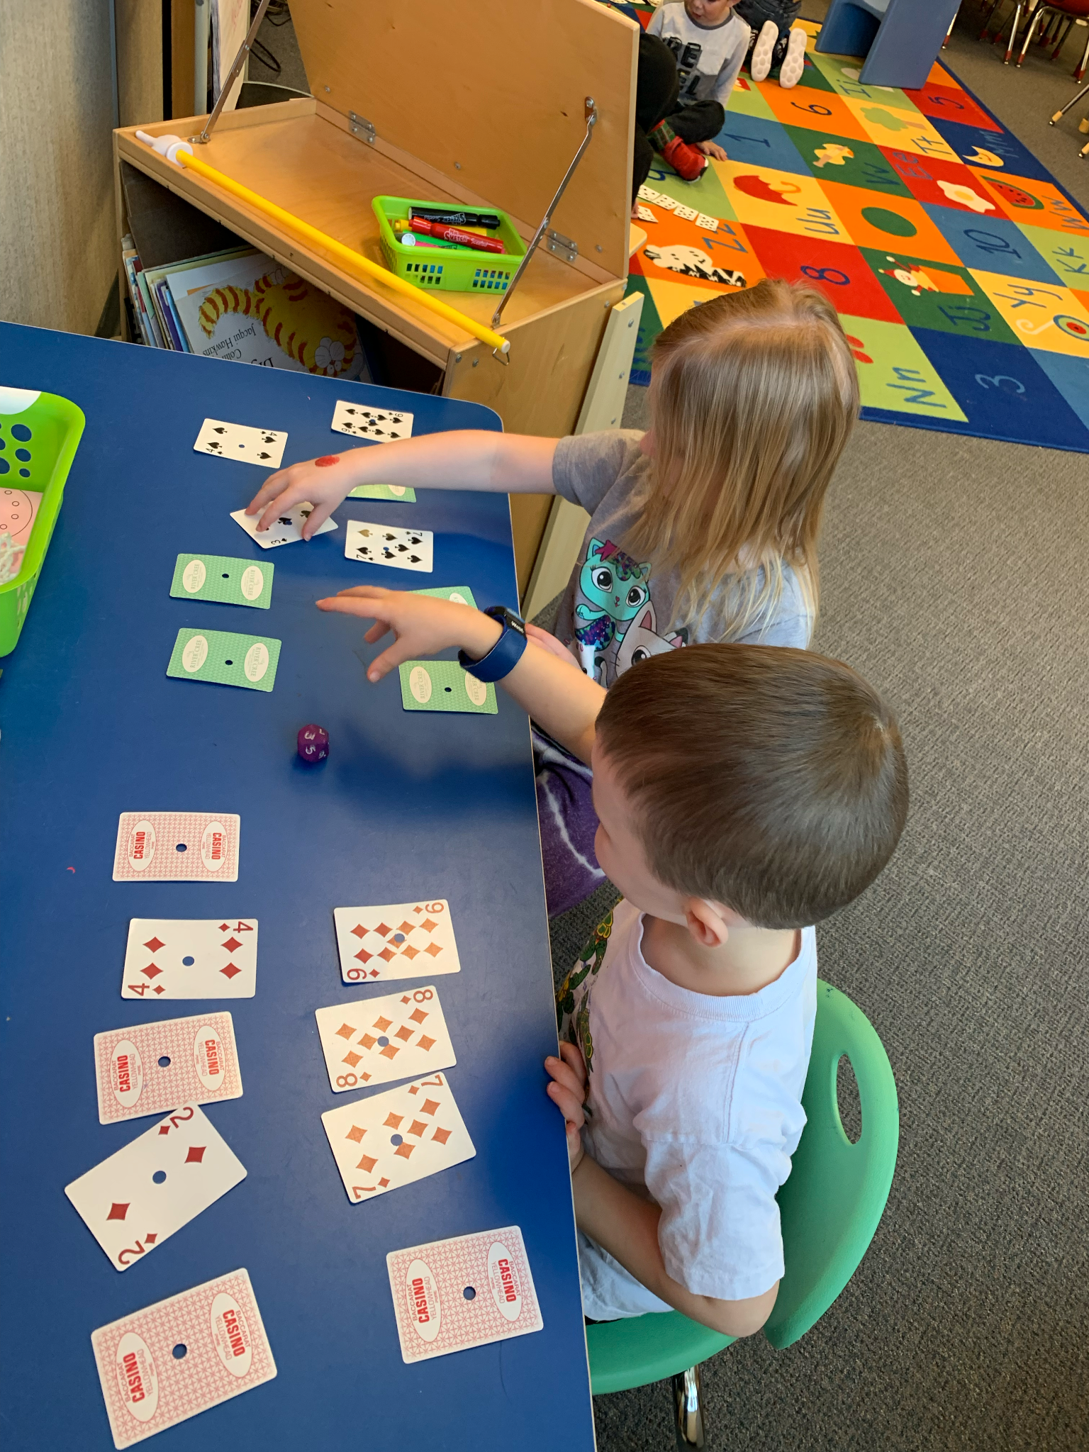
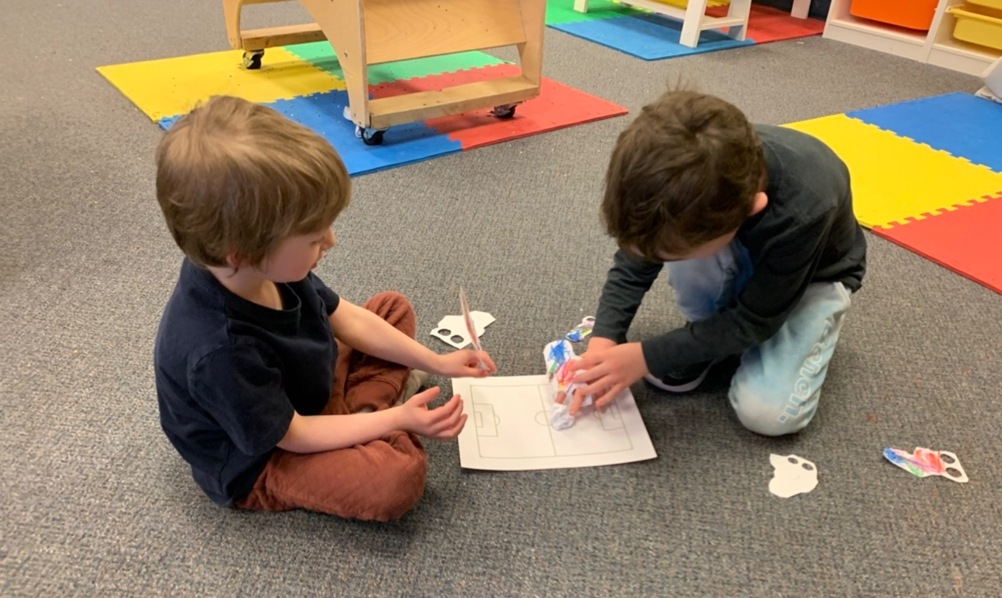
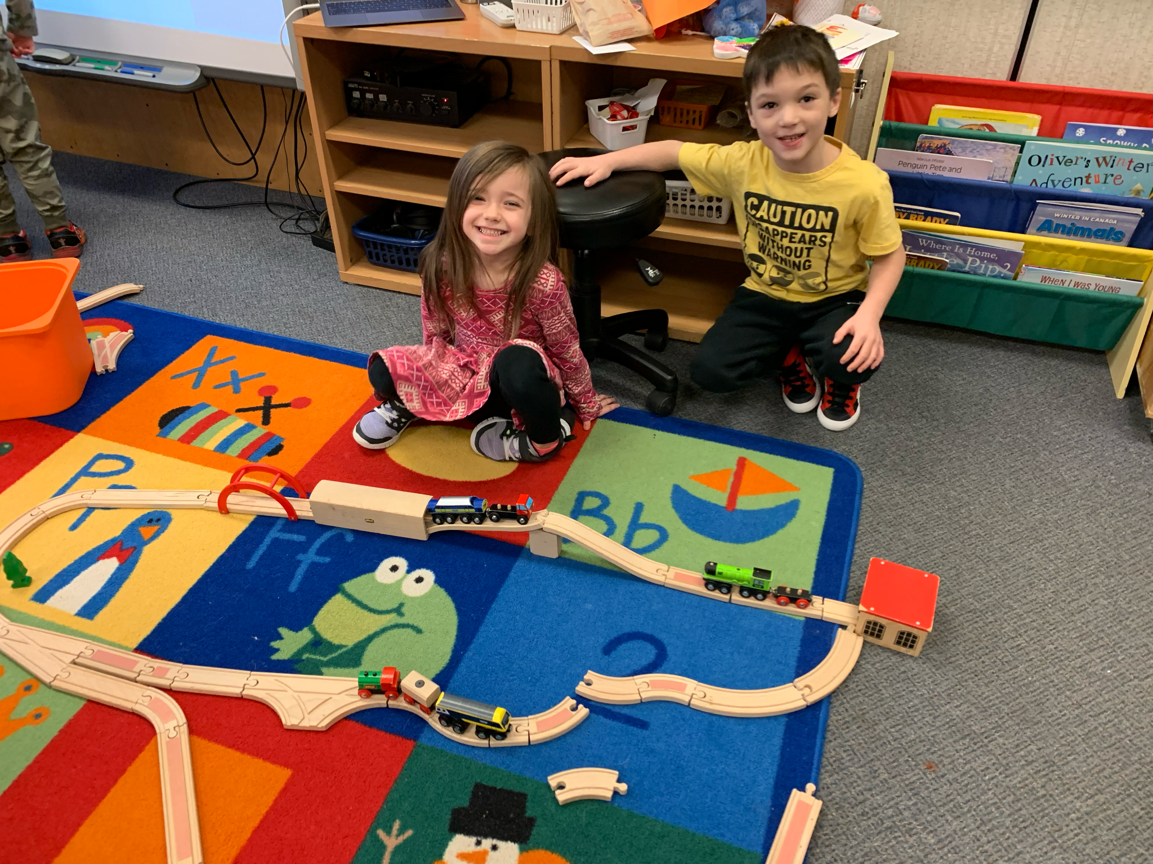
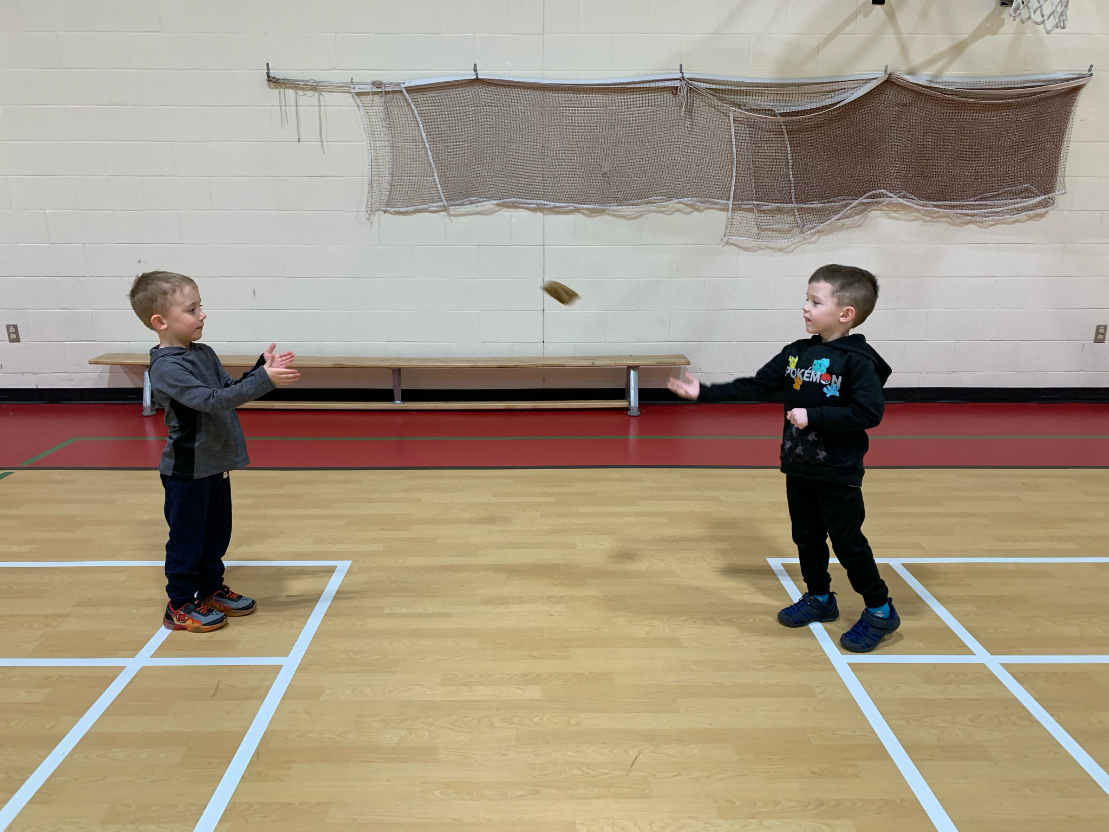
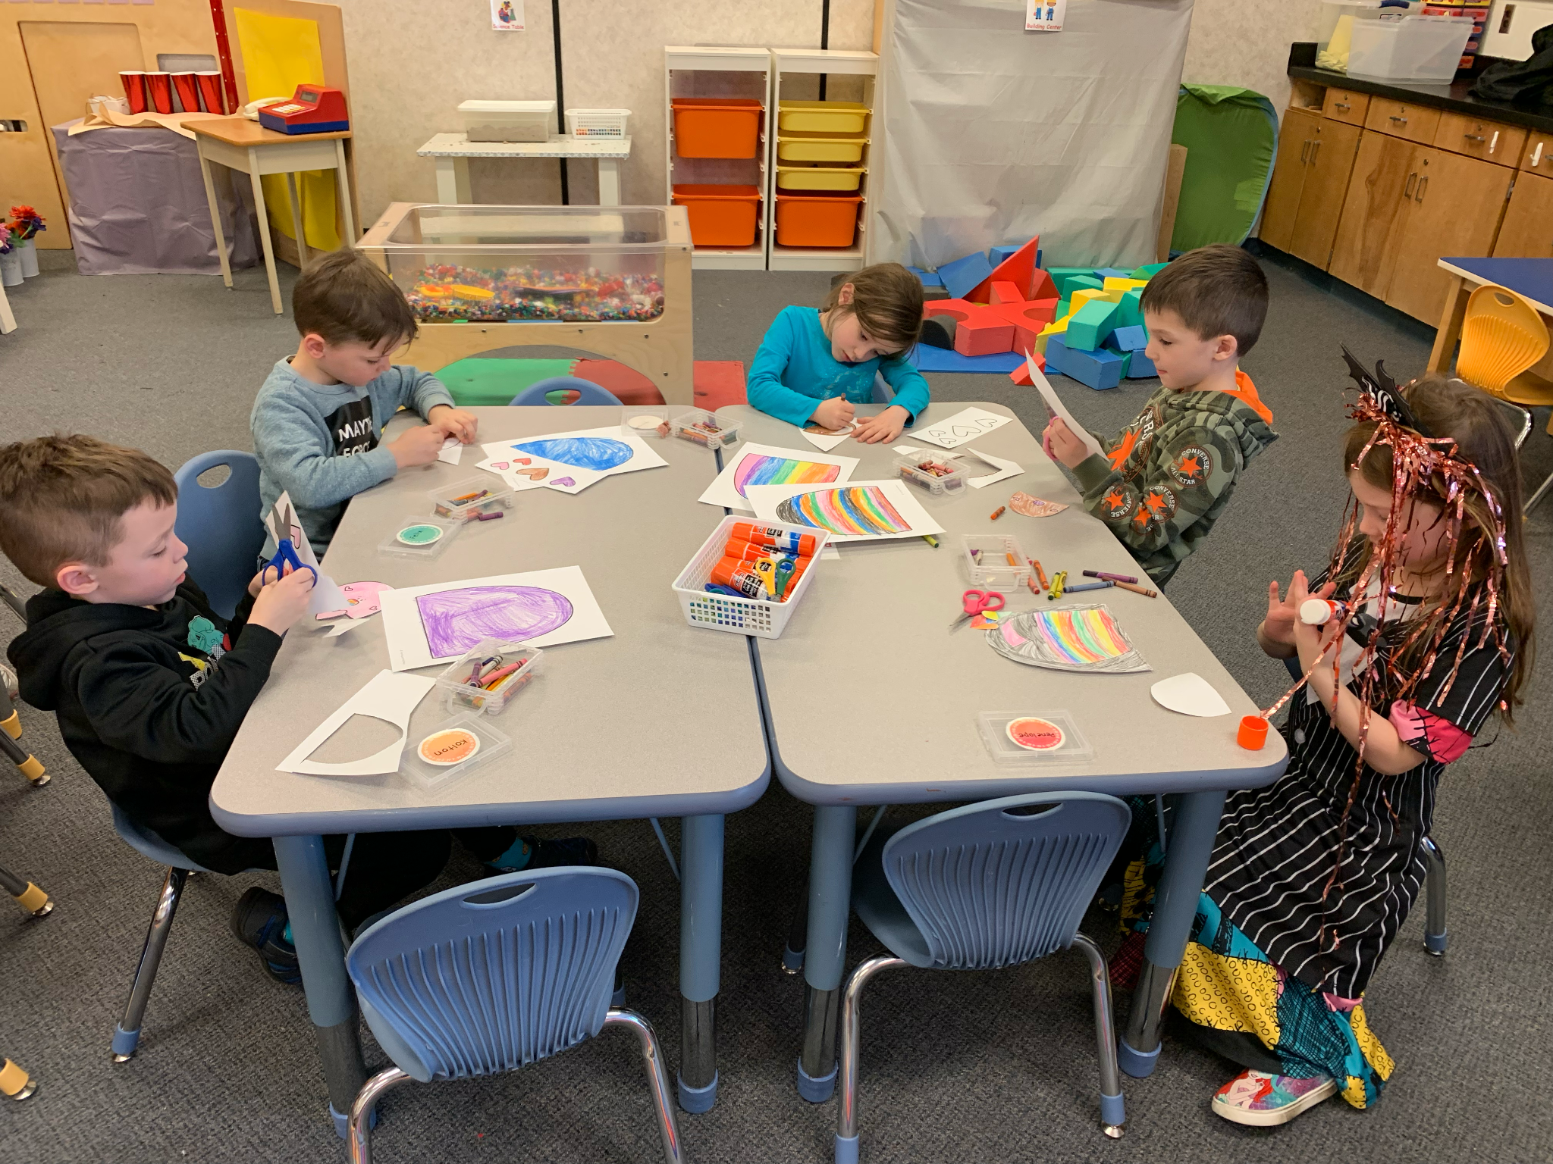
Full Day Kindergarten

Slide 7
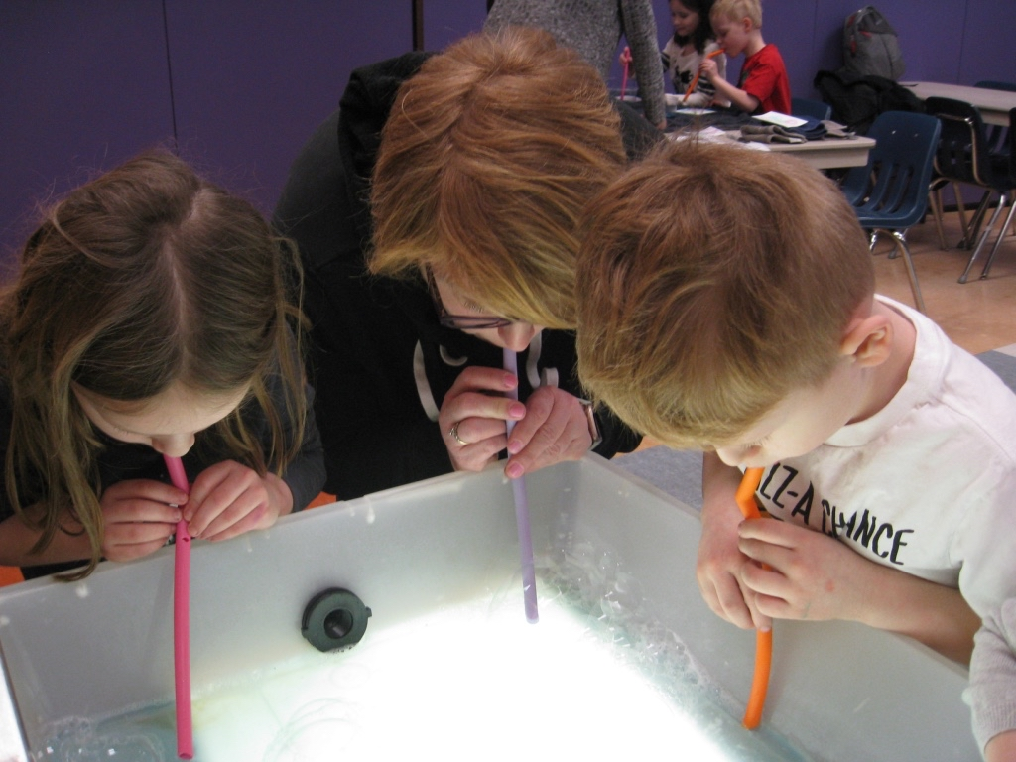
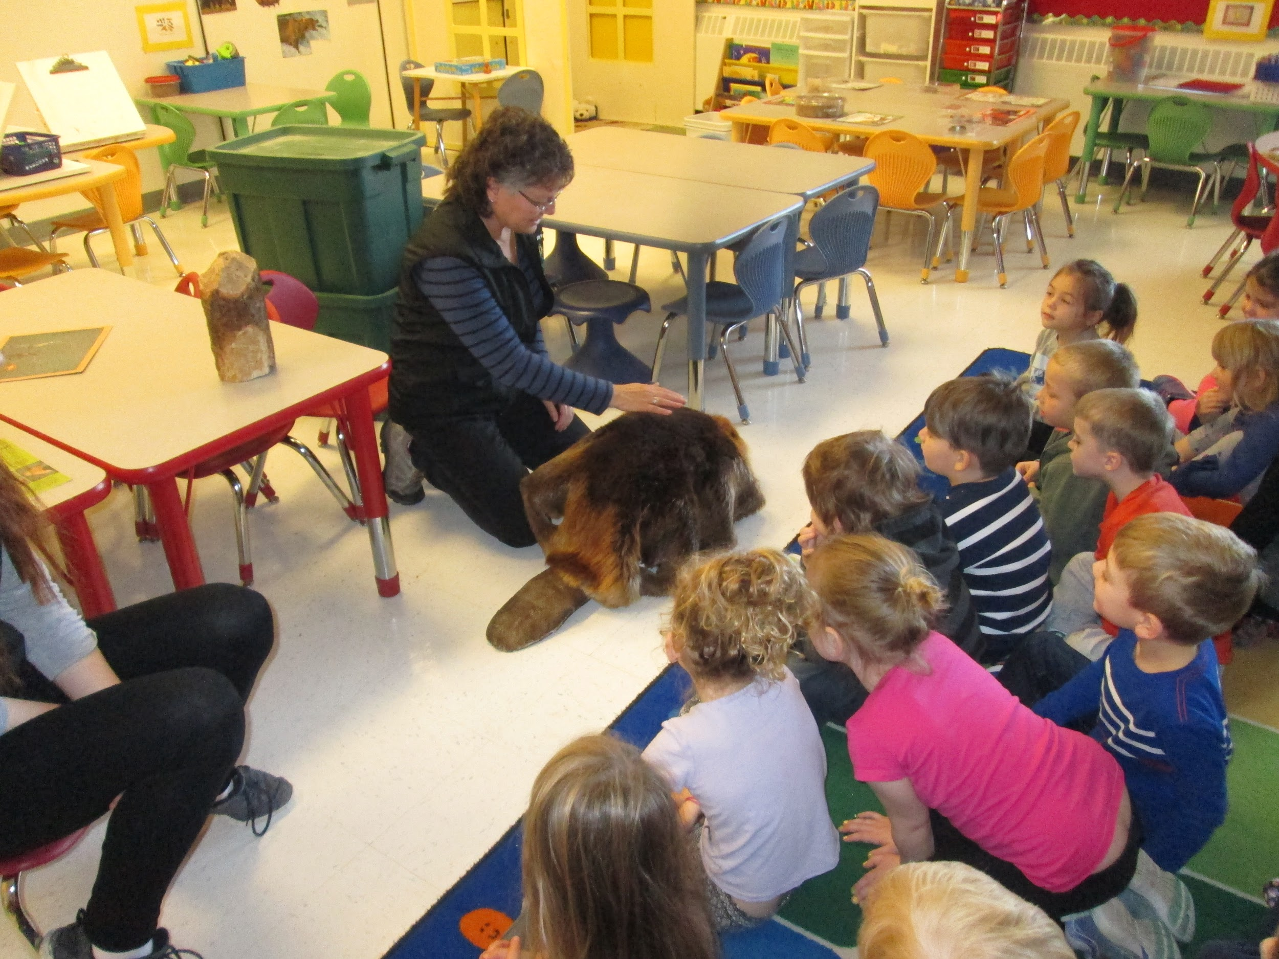
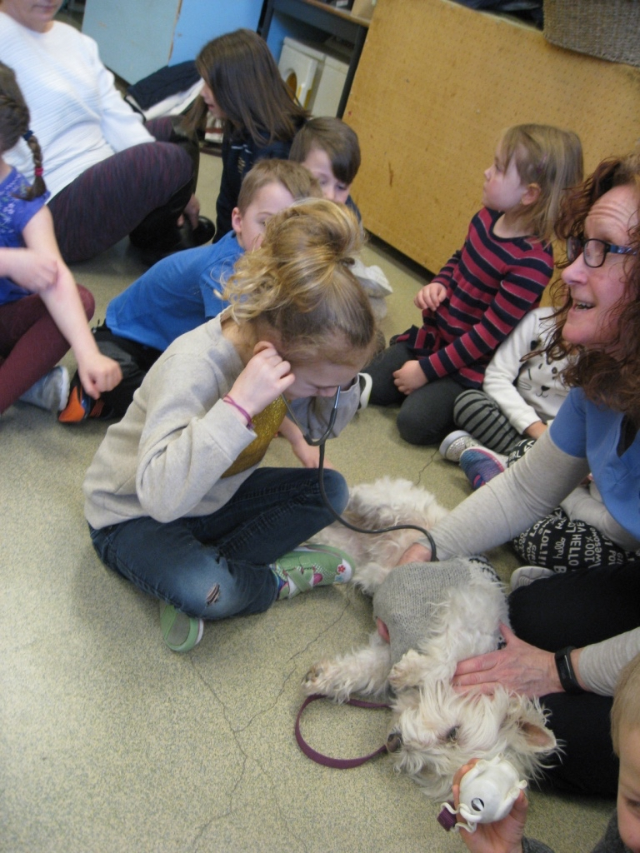
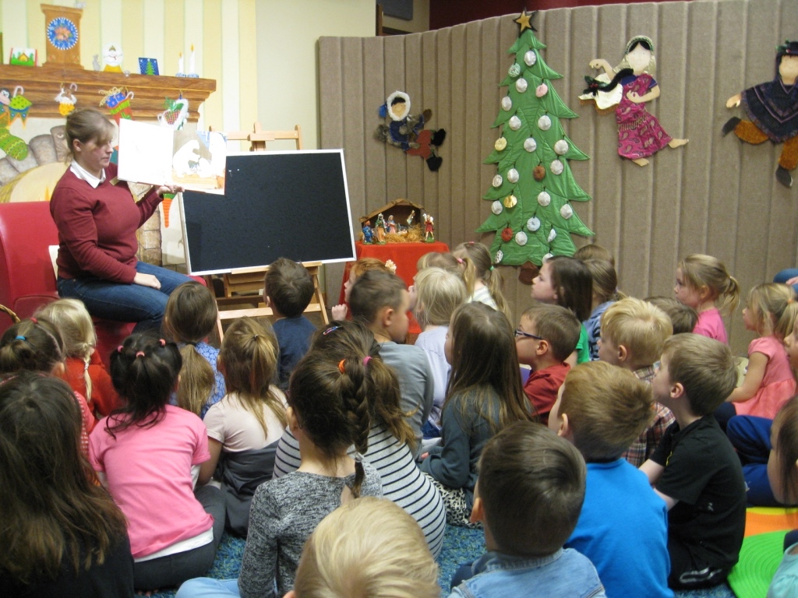
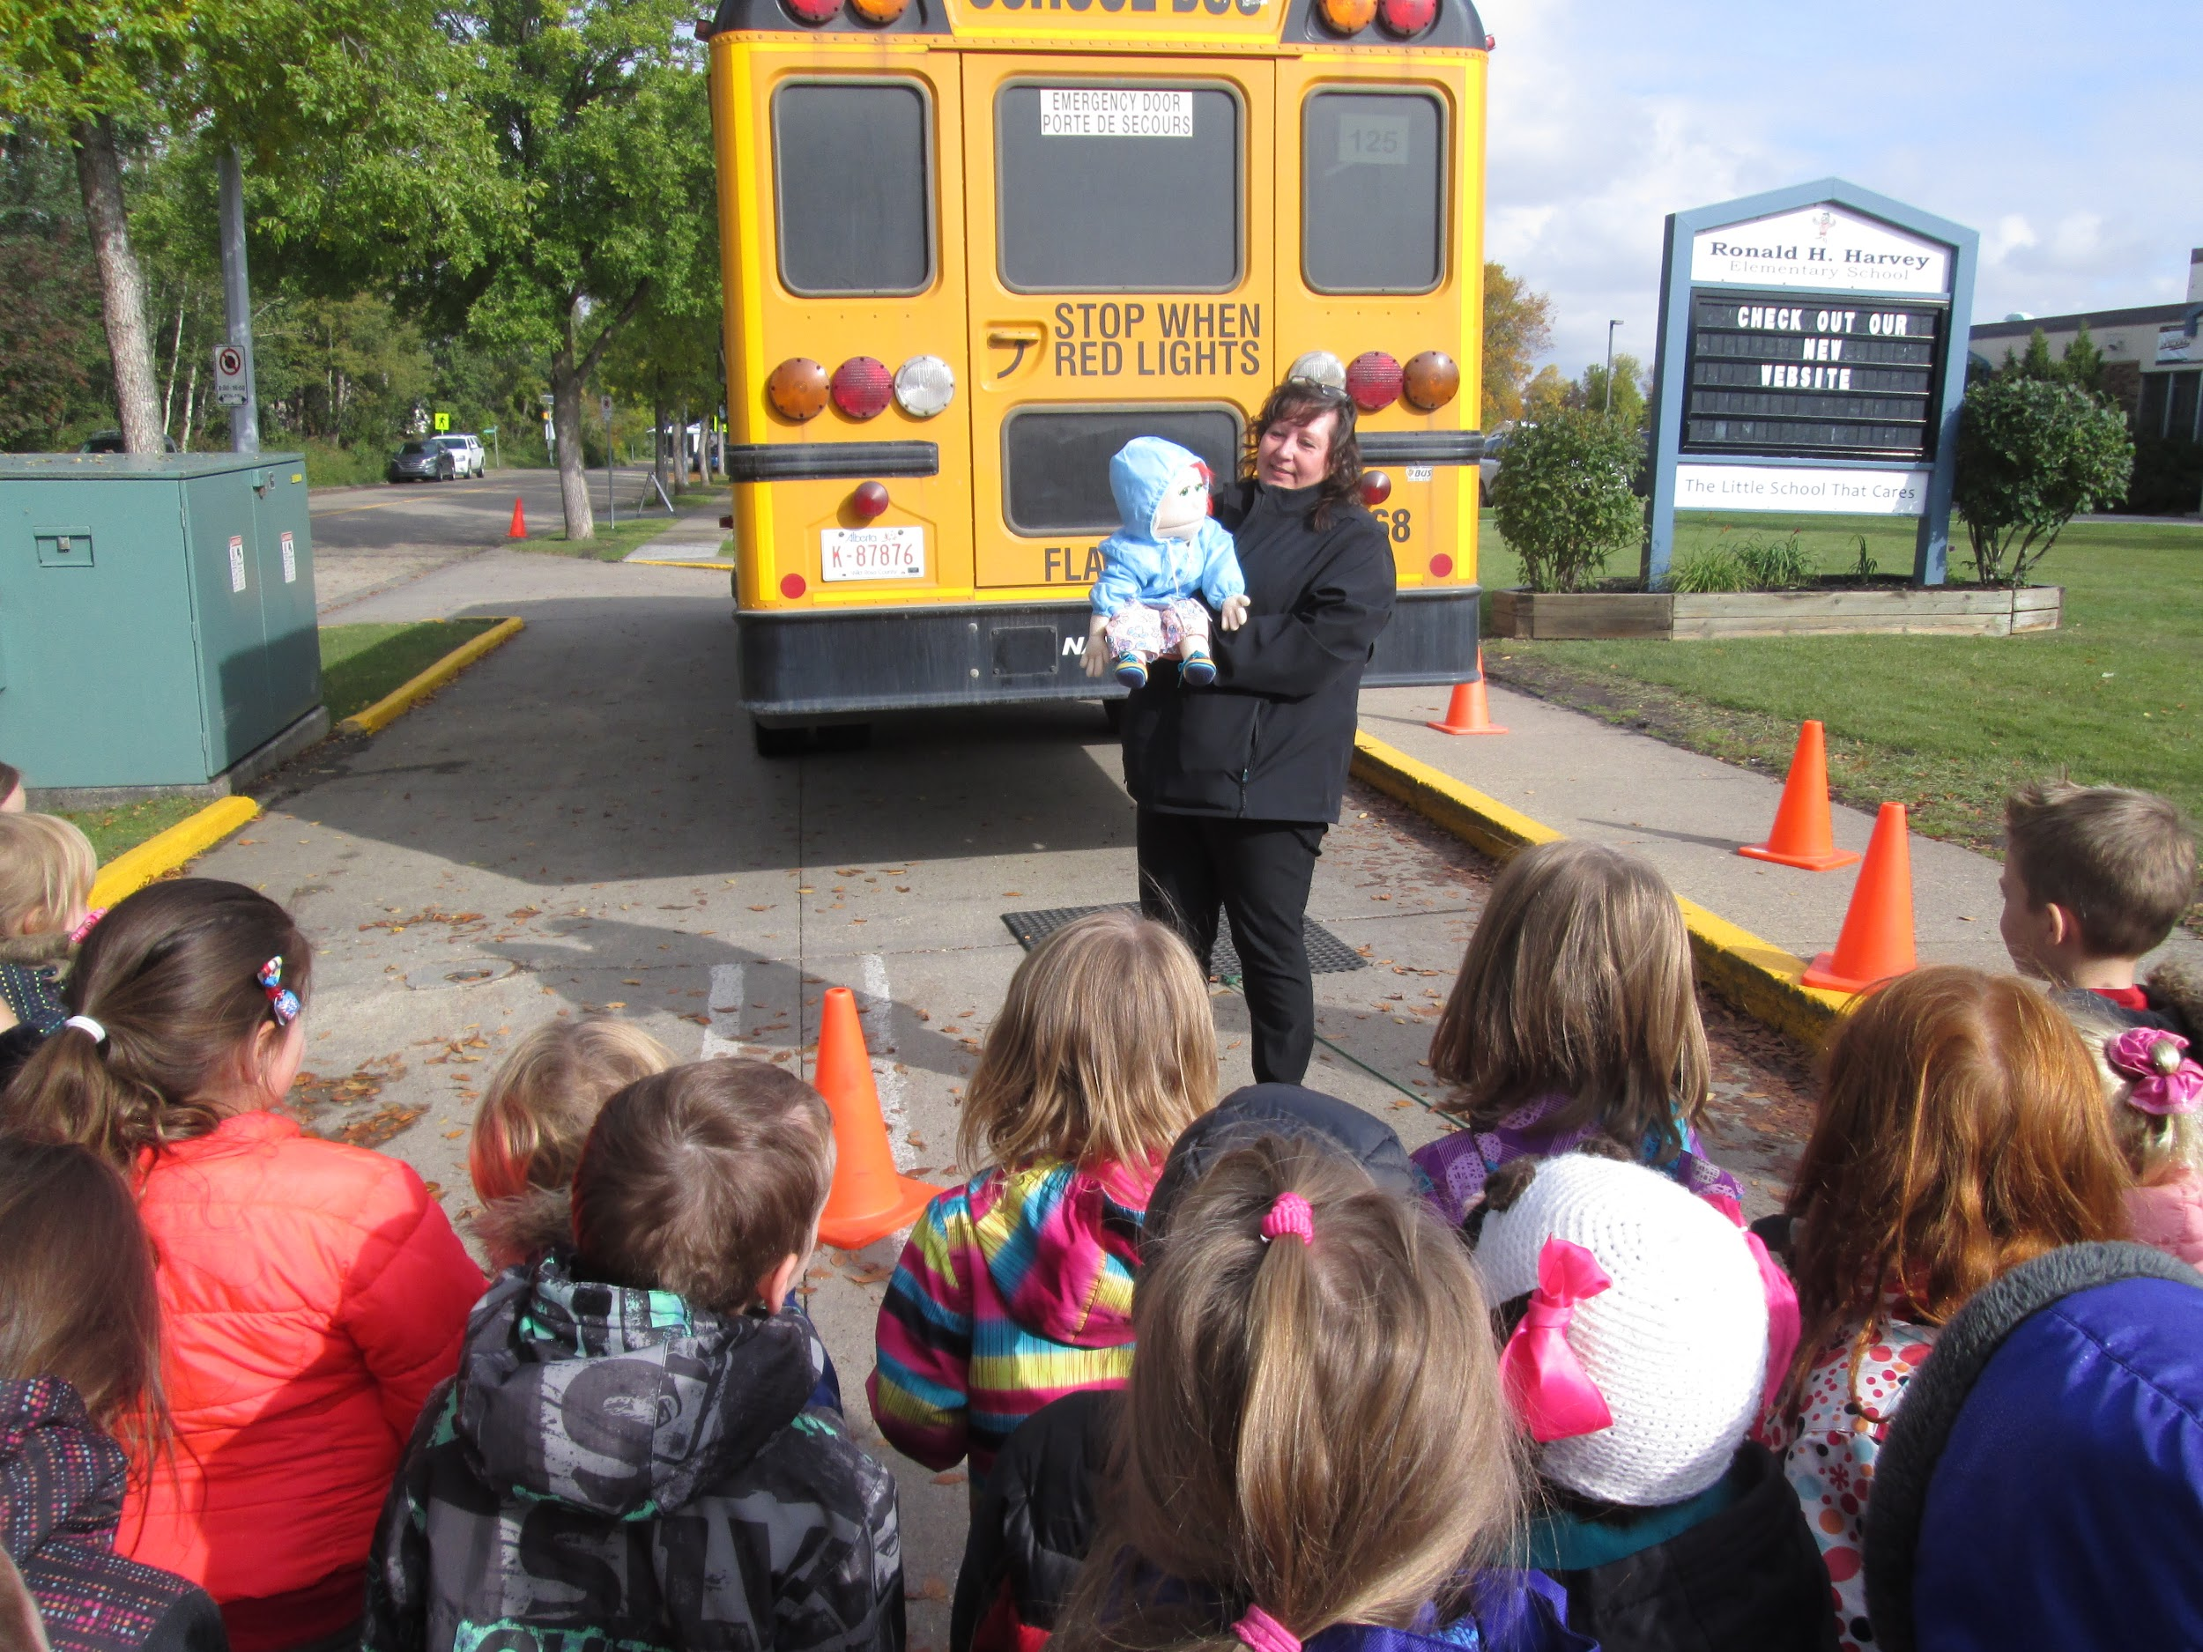
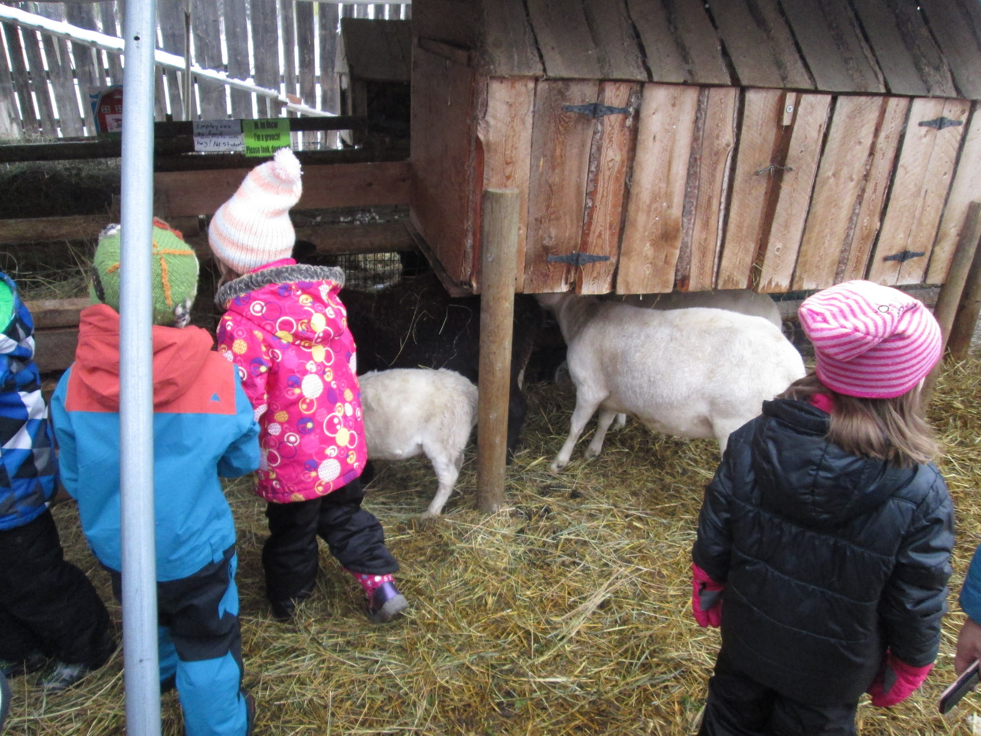
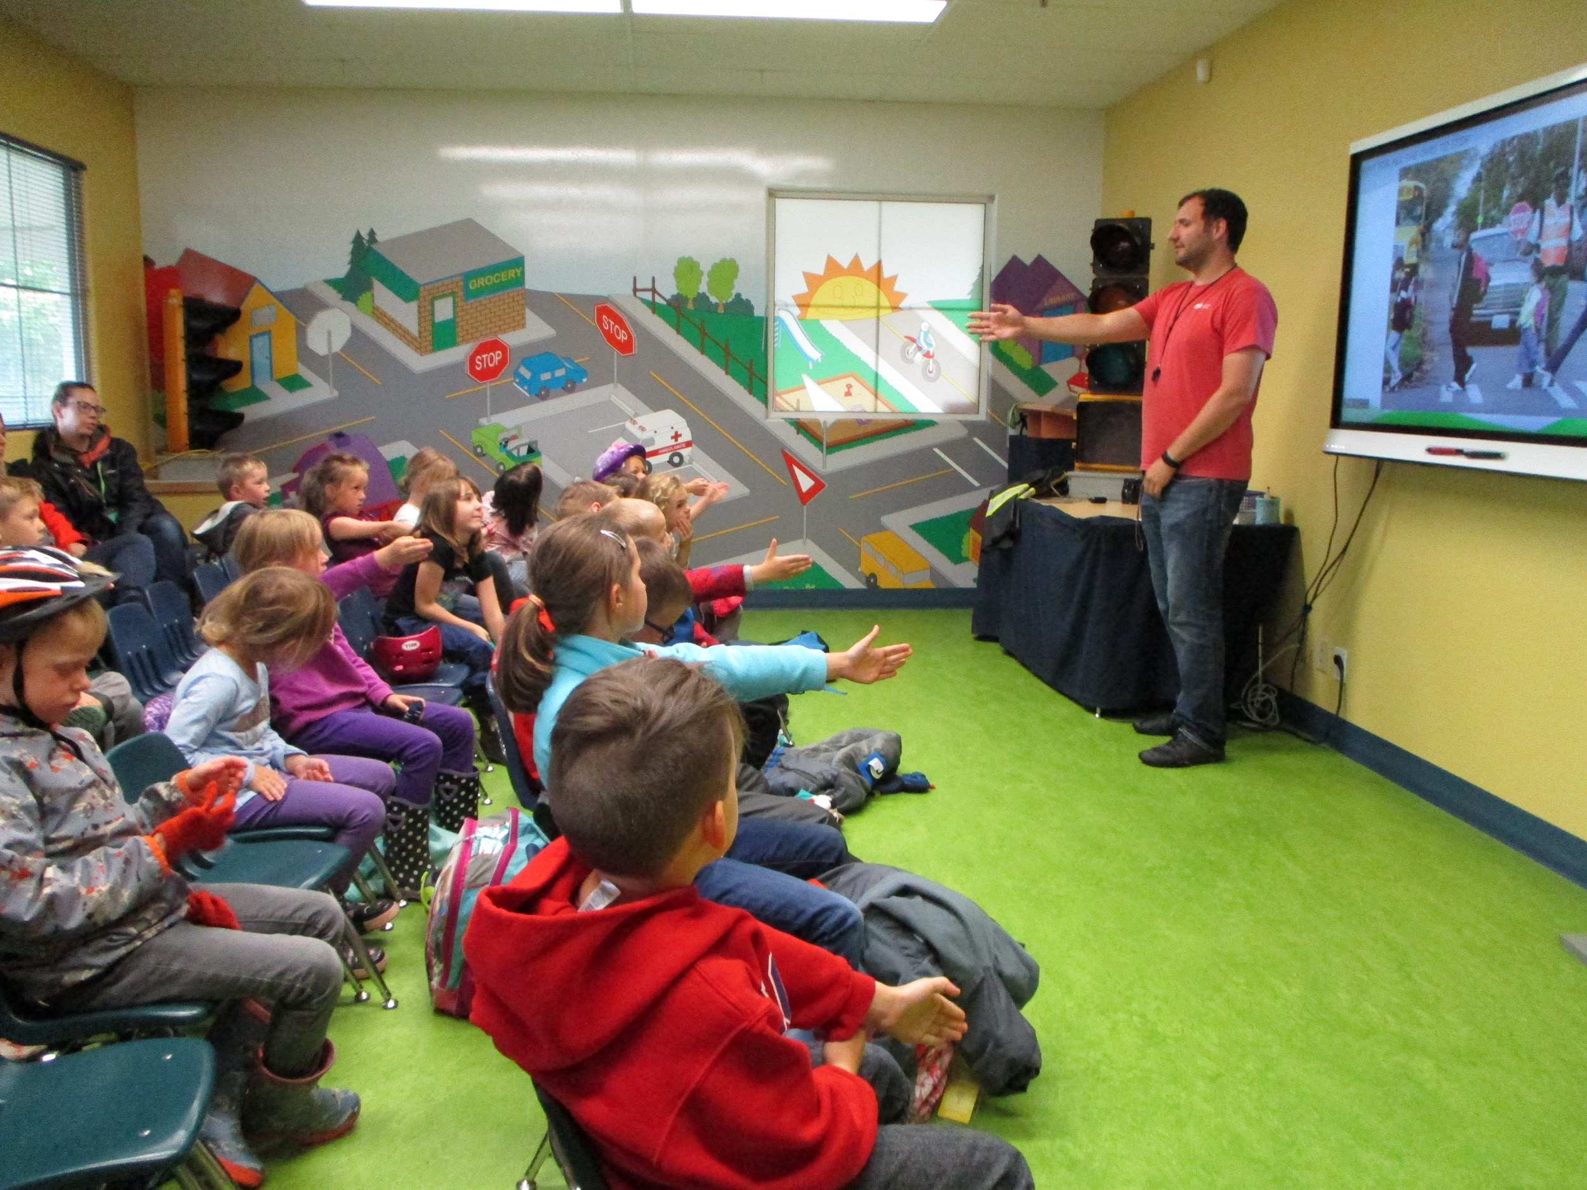
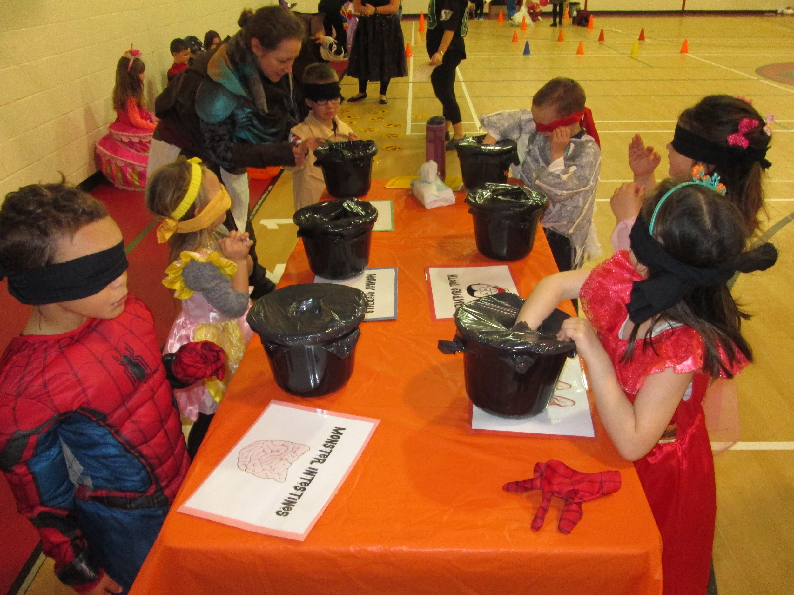
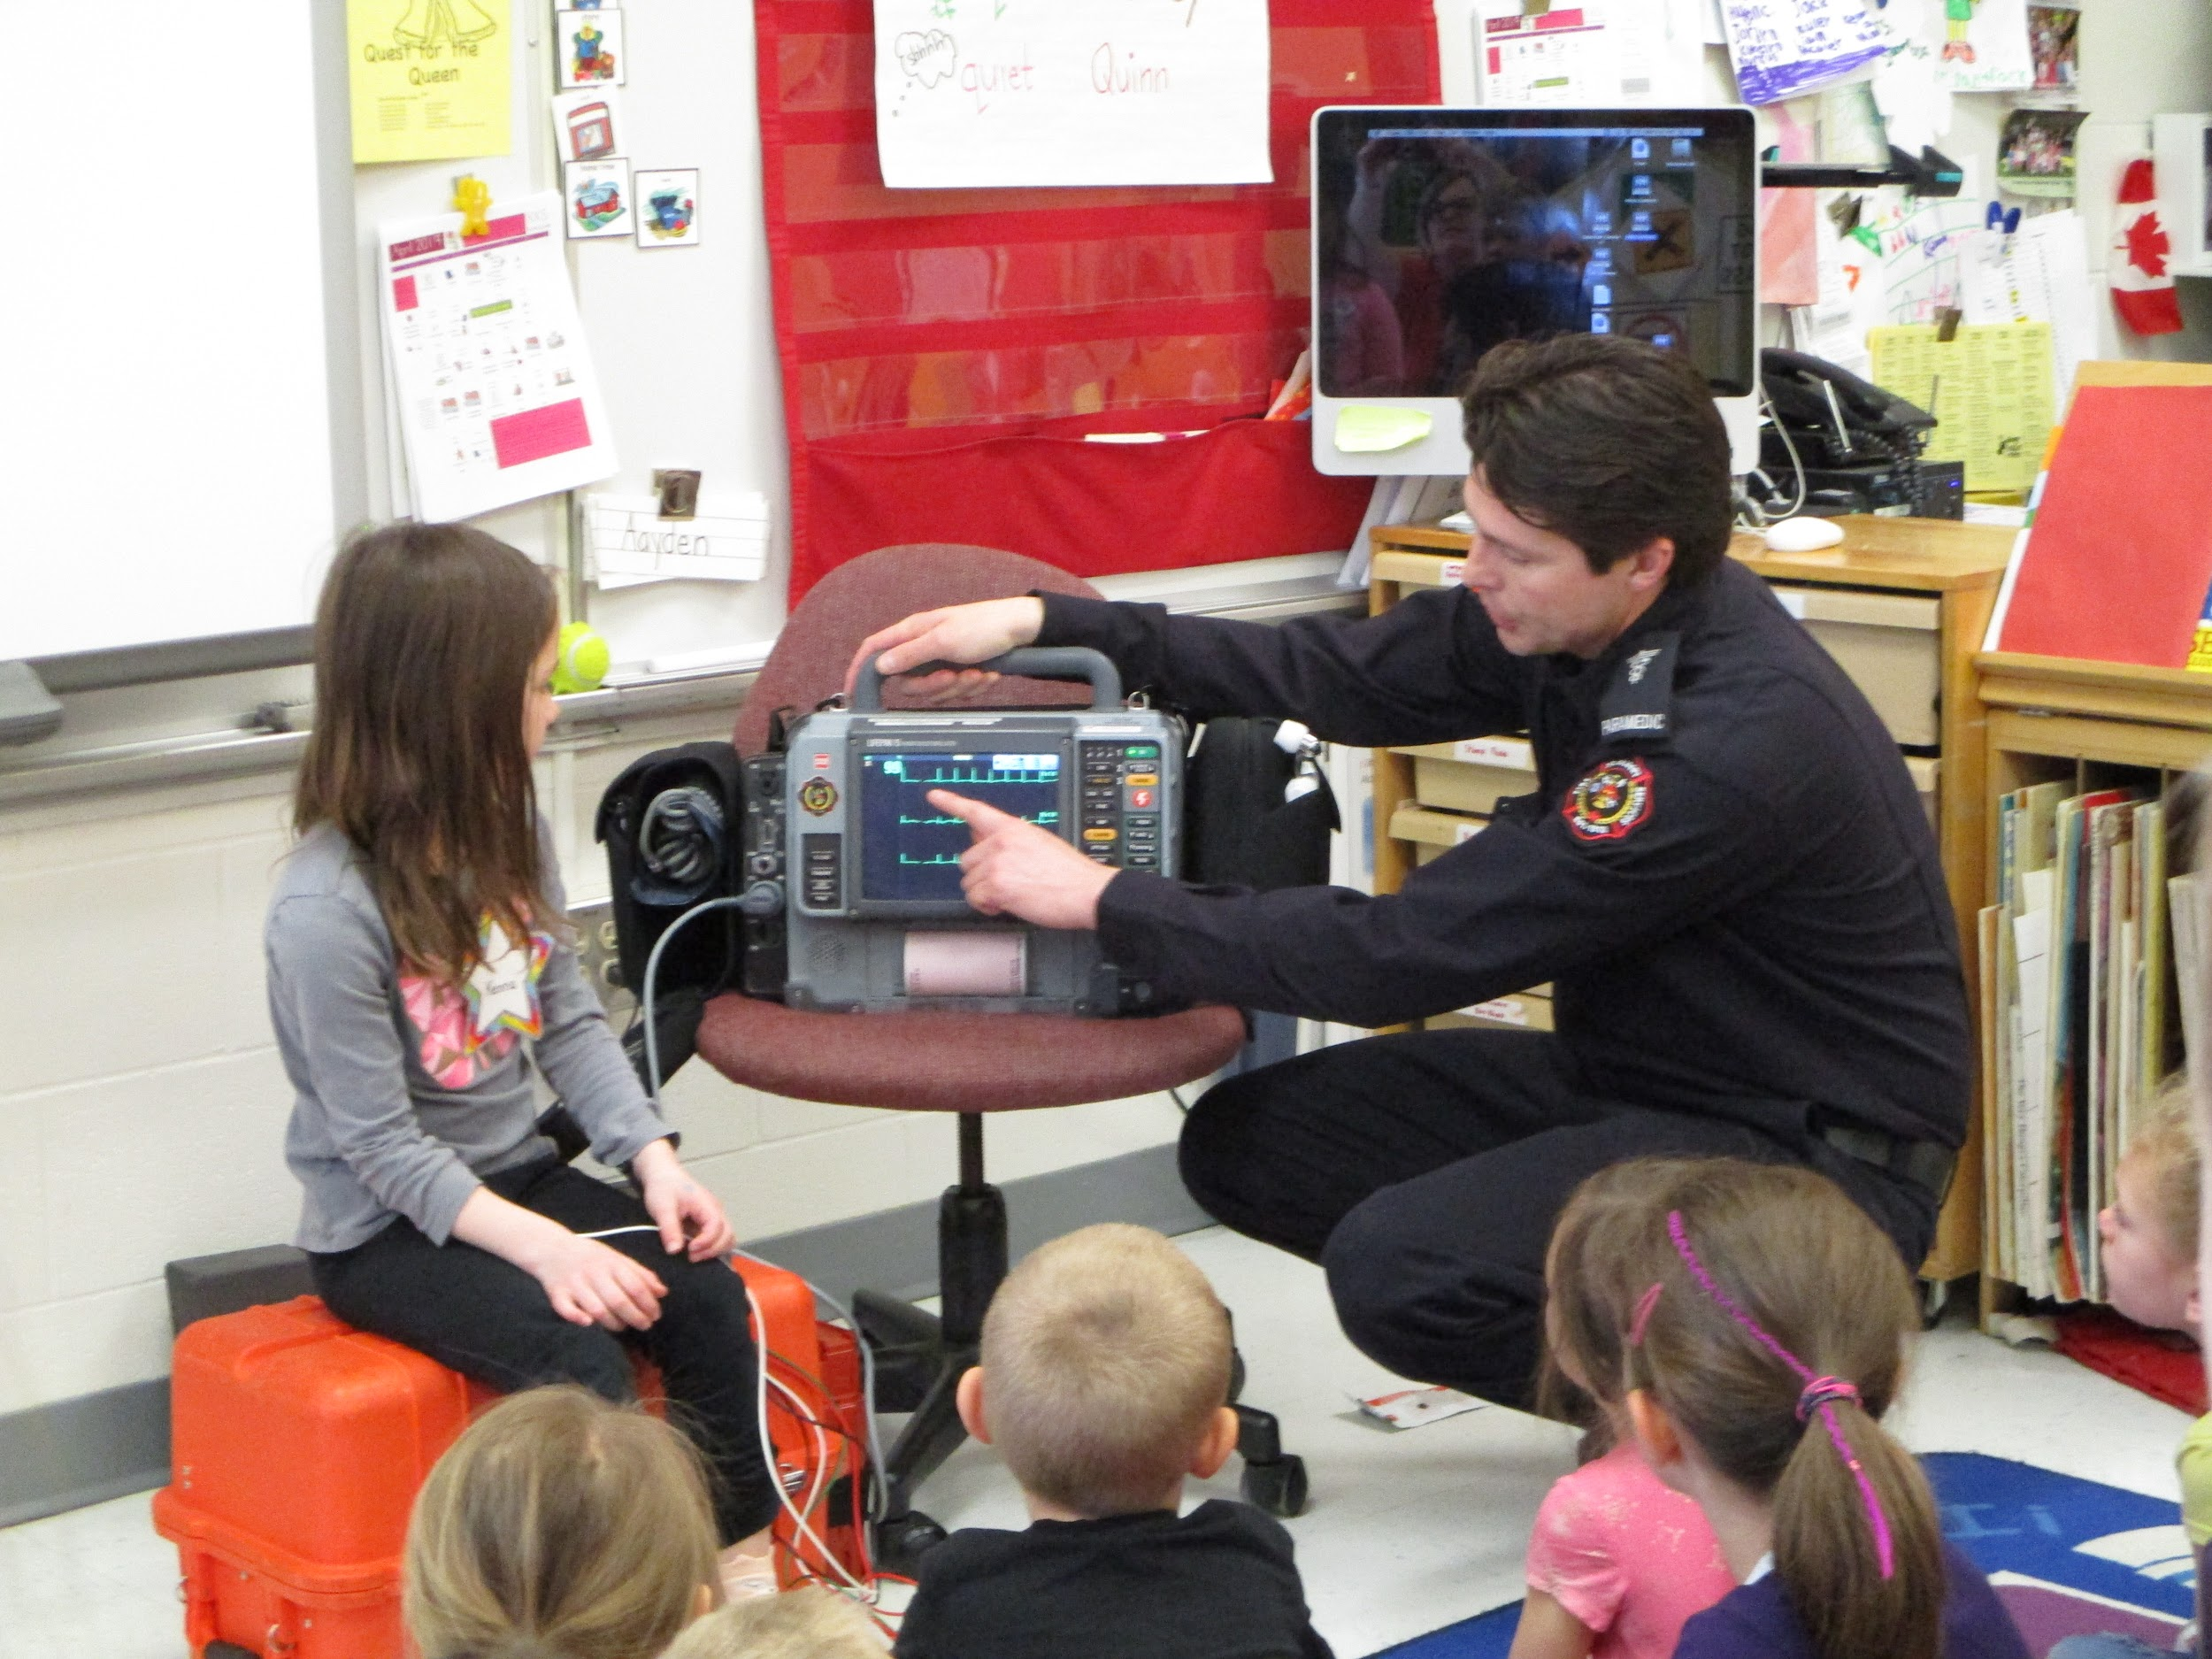
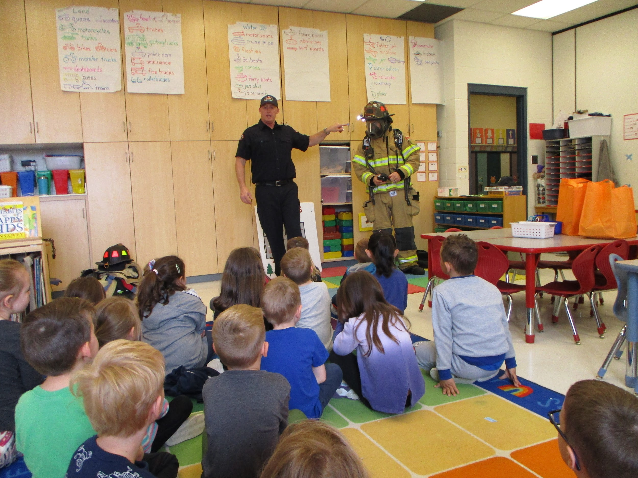
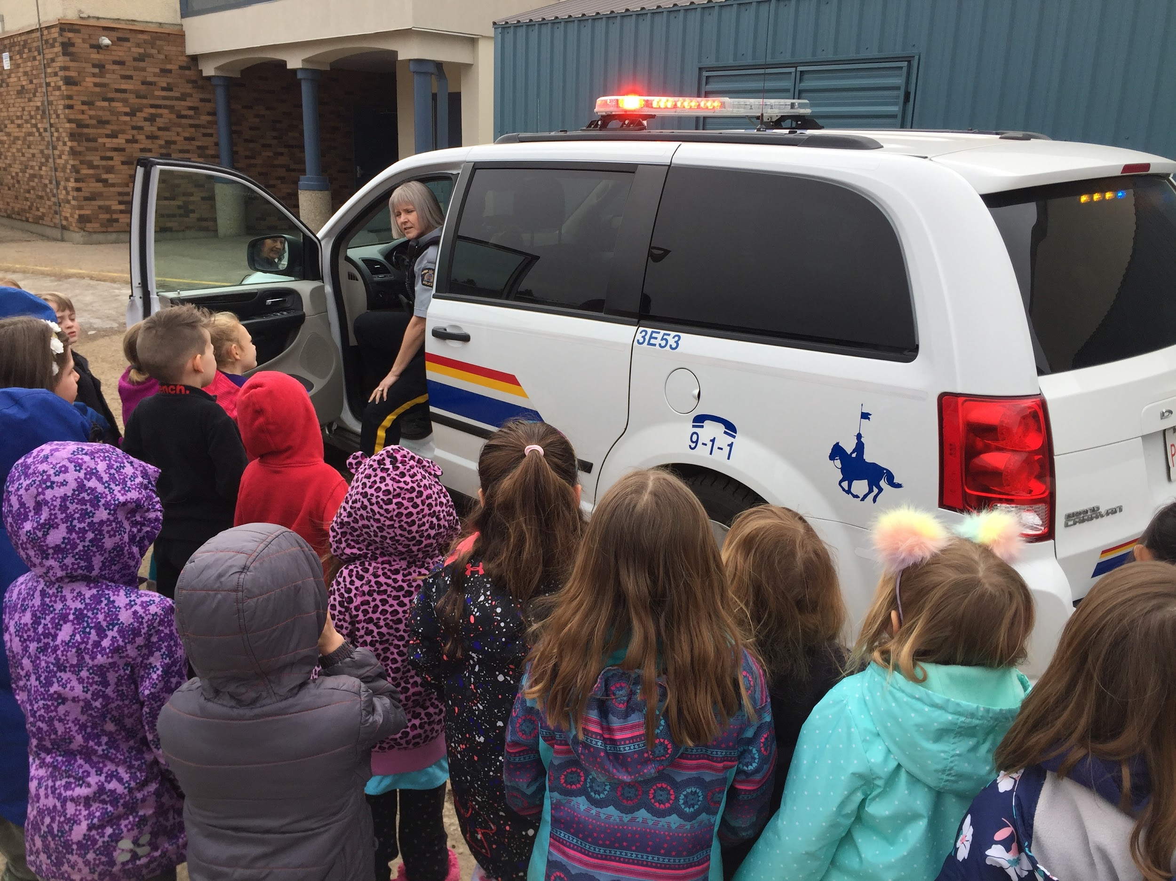
Field Trips and In Class Events
Venturing out into the community as well as having special guests in the classroom offers unique learning experiences for our students. Our classes have many opportunities throughout the year to engage in a variety of learning environments.

Slide 8
Kindergarten Fees
All Kindergarten students - $220 activity fee for the year
Full Day Students - an additional $325 per month

Slide 9
Kindergarten Start and End TImes
Morning Kindergarten
School day begins at 8:55 a.m. and ends at 11:40 a.m.
Afternoon Kindergarten
School day begins at 12:45 p.m. and ends at 3:22 p.m.
Full-Day Kindergarten
School day begins at 8:55 a.m. and ends at 3:22 p.m.

Slide 10
Families As Partners
There are many opportunities throughout the school year to partner in the classroom, on field trips or with take home projects.
These may include:
Kindercooking
Scrapbooks
Mystery Readers
Theme Based Projects
Sharing Expertise
Playdough

Slide 11
Before and After School Care
At Ronald Harvey there is out of school care provided by SIGIS Childcare Society. Visit their website for more information.

Slide 12
Transportation
Bussing may be available for your child. Please contact district office at
(780) 460-3712, ask for transportation, or click on the bus to get to their link!

Slide 13
Next Steps
Test Drive - Wednesday, May 3
Registration
Email in the Summer
Small Group Orientation
Thursday, August 31
Friday, September 1
Tuesday, September 5

Slide 14
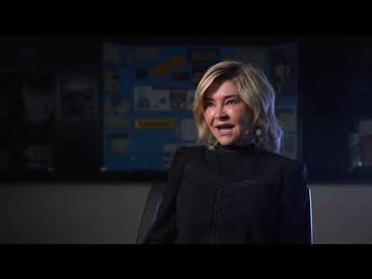
Kindergarten Readiness

Slide 15
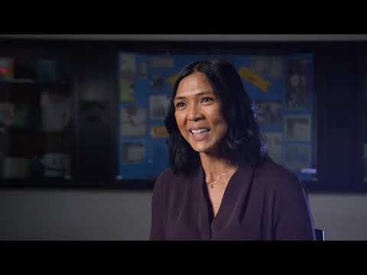
Kindergarten Supports

Slide 16
Please contact us with any questions you may have!
School Phone: 780-459-5541
Sue Anderson
susan.anderson@spschools.org
Kelly Hauptman
kelly.hauptman@spschools.org
Megan Sneddon
megan.sneddon@spschools.org
Kim Miller
kimberley.miller@spschools.org

Slide 17
We’d love to see you in the fall!
Register Now!

